Slide 1
To do
Friction toevoegen dataset
Noise toevoegen in closed-loop → meest nuttig voor ASMPT
Figuren maken en slides fixen wat Quiten voortselde
  Ook figuren nuttig die gyorok in zijn paper heft
  Overlapp ANN met baseline met en zonder orthognality
Full black box met of zonder BLA init? Kijken deepsi voorbeeld.
Baseline additional states orthogonal
Figures kijken gyorok orthogonal by contruction
Closed loop frf
Performance of excitation is niet goed zegt maarten
Hoe doe ik proper experiment design dan…?

Slide 3
Look into experiment design. Maarten and roland discussion said I don’t have gyorok his excitation / proper experiment design.
❯ for theorethical purposes i want a dataset where we enfore/have this: Jᵀ Δ* = 0 and hopefully it is a physical meaningful realizationYes, this is constructible, and the clean lever is the excitation, not the plant. You keep the hidden MSD exactly as it is; you design the multisine that drives it. That is ordinary experiment design, so it stays physically meaningful.Why it works. On a standstill record Y is fixed, so M(Y) is constant and the baseline is exactly LTI. Both sides of the inner product are then linear filters of the same input: the sensitivity column is R_j(ω)U(ω) and the added dynamics is F_a(ω)U(ω), with R_j and F_a known in closed form from the baseline and absorber models. The multisine sits on exact FFT bins (gtd_make_multisine already guarantees this), so distinct lines are exactly orthogonal over the record and<J_j , Delta*> = sum over lines c_j(omega) p(omega), c_j = Re[ R_j^H W F_a ], W = M^-T M^-1with p(omega) = |U(omega)|^2 the power spectrum. The inner product is linear in the power spectrum, and independent of the phases. So Jᵀ Δ* = 0 is ten linear equations in a few hundred nonnegative line amplitudes. That is a wide feasibility problem, not an overdetermined one.The design problem, stated. Choose p(omega) >= 0 per line and per channel such that- sum c_j(omega) p(omega) = 0 for all ten j, which is the orthogonality condition;- ||Delta*|| stays large, so the augmentation still has something to learn;- cond(J) stays low, so the parameters stay identifiable;- the existing force RMS and peak limits hold.Ten equalities plus inequality constraints in the nonnegative orthant: a linear program. The solution is a designed amplitude spectrum, and everything else about the dataset stays as it is.What it costs in honesty. Three things, all small and all checkable:1. Exactness needs frozen Y. Build the orthogonal dataset from standstill records at several Y values, one LTI system each, with the amplitudes of each record as separate design variables. Y-sweep records can stay in the set as a held-out family, outside the orthogonality guarantee.2. The ma·da term in the mass matrix is a genuine weak nonlinearity, so the construction is exact only to that order. Residual measurable directly.3. c_j should be computed over the exact reference-set window (the trimmed, hold-plus-active record the tuples are actually built from), not over idealised whole periods. Otherwise the hold segost.And one free improvement regardless of all this. Set L0nstant from the same mass-matrix entry as (m1−m2)Lb/2,which is the 98.8 percent direction. Mounting the absorber at the payload's rotation centre is physically natural, it is one line ingtd_config.m, and it makes the LP's job far easier by rl coupling before the design starts.Recommendation, one thing. Write design_orthogonal_exci compute c_j(omega) on the exact reference-set windowfrom the closed-form baseline and absorber models, at L0 = 0, solve the LP for the line amplitudes, and report the predicted rho* and J⁺Δ* for the designed spectrum before anyone regenerates a dicted rho* comes out at the numerical floor, the designis worth the regeneration; if it does not, we learn that cheaply and adjust the constraint set. It reuses the measurement machinery already built and needs no new data.Say go and I will build it.

Slide 4
Change parameters to telica instead of Garcia?

Slide 5
Why route through all states
Roland suggested only doing velocity?

Slide 6
Meeting 18-09
Last week
  Orthogonal regularization
Orthogonal by construction
Questions
Notes:
Delayed state
Wouldn’t have issue encoder or I don’t have the velocities
But then I would orthogonalize also what is not in the baseline

Slide 7
Meeting 18-09
Kijken feedback laatste meeting
  Voor encoder transient error
Vooral keuzes laten zien voor orthogonal by construction implementeren
  Per epoch
  Not full state estimate FP model like in orthogonal regularization approach
    Encoder init once (frozen)
    But update orthogonality space based off of parameters each epoch (due to detuned init)
Vooral resultaten laten zien of het werkt of niet
  Als het niet voldoende is → reden om uit te breiden.

Slide 8
Transient issue encoder

Slide 9
Delayed states
Reason orthogonalize for that
No need to adjust for encoder etc.
Current approach detune baseline parameters not based on the training data? Exactly based by imperfect baseline model.
But then we orthogonalize also to what the baseline doesn’t capture

Slide 10
NEW SLIDS NEXT SLIDE

Slide 11
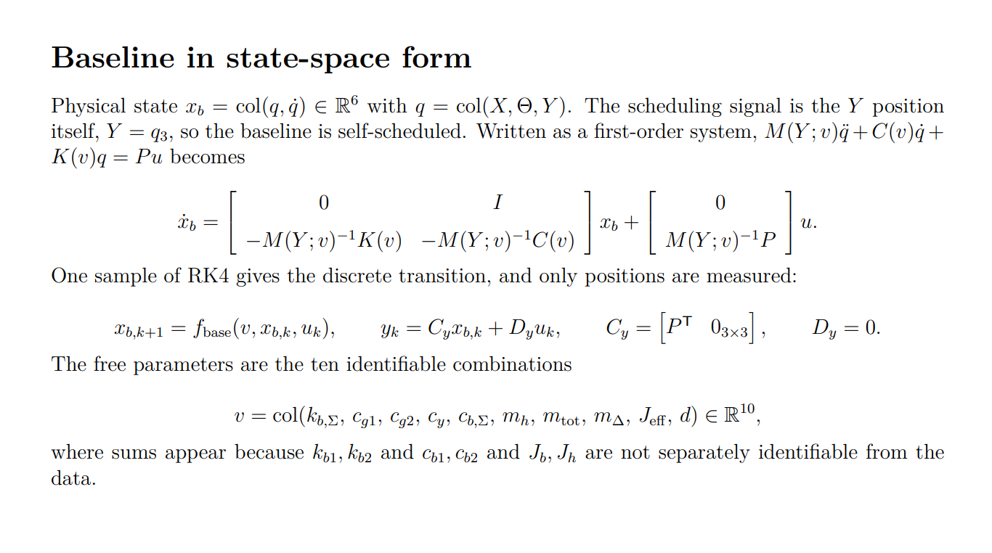
Notes:
Stack them. Each block is 3x3, so the result is 6x6:
M = [ m1+m2+mb+mh (m1-m2)Lb/2 - mh*Y 0 ]
[ (m1-m2)Lb/2 - mh*Y Jb+Jh+(m1+m2)Lb^2/4 + mh*d^2 + mh*Y^2 -mh*d ]
[ 0 -mh*d mh ]
m_h (head mass, raw parameter): the only mass that moves relative to the structure. Every Y and Y^2 term in M carries mh, so mh is the entire reason the model is parameter-varying. It also couples Y and Theta through -mh*d (the head sits an offset d off the beam axis, so accelerating it in Y torques the beam). If mh were zero, M would be constant and the baseline would be LTI.
m_tot = m1 + m2 + mb: the mass translated in X. Note M(1,1) = m_tot + mh, so the total translating mass is m_tot + mh. mh has to stay a separate parameter because it also appears alone in the Theta and Y rows, so the two cannot be merged into one number.
m_Delta = m1 - m2: the imbalance between the two driven ends. It appears only as (m1-m2)Lb/2 in the off-diagonal, so it is the X-Theta coupling: with unequal end masses, a pure X force also produces beam rotation. Only the difference is identifiable, never m1 and m2 separately, and it is signed (can be zero or negative), which is why it is the one entry of v not trained in log coordinates.
$$P=\left[\begin{matrix}1 & 1 & 0 \\ L_{b}/2 & −L_{b}/2 & 0 \\ 0 & 0 & 1\end{matrix}\right], L_{b}=0.725 m.$$
$$y=\left[\begin{matrix}X_{1} \\ X_{2} \\ Y\end{matrix}\right]=P^{T}\left[\begin{matrix}X \\ Θ \\ Y\end{matrix}\right]=P^{T}q,$$
$$q=P^{−T}y=\left[\begin{matrix}\frac{12}{}\frac{12}{}0 & & \\ \frac{1}{L_{b}} & −\frac{1}{L_{b}} & 0 \\ 0 & 0 & 1\end{matrix}\right]\left[\begin{matrix}X_{1} \\ X_{2} \\ Y\end{matrix}\right].$$
$$X=\frac{X_{1}+X_{2}}{2}, Θ=\frac{X_{1}−X_{2}}{L_{b}}, Y=Y_{measured}.$$

Slide 12
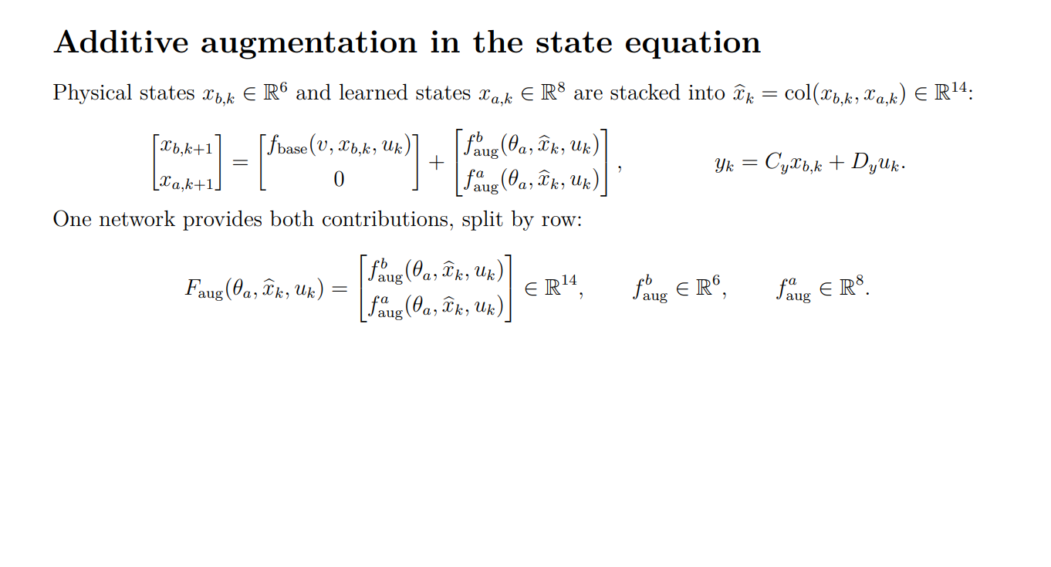

Slide 13
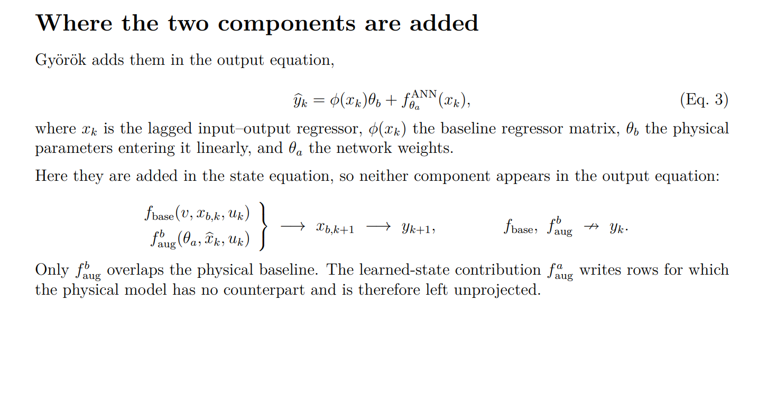

Slide 14
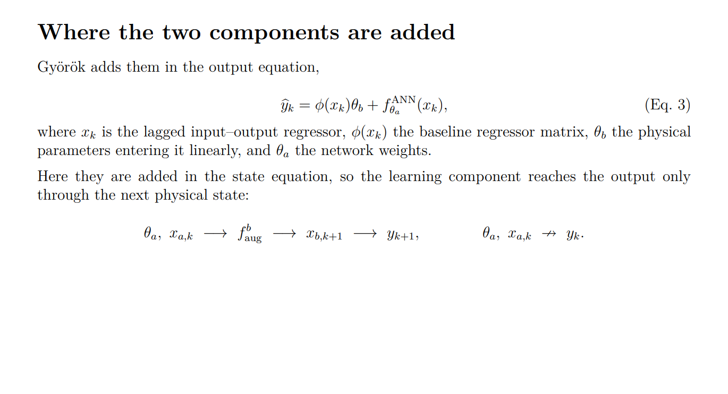

Slide 15
END PREVIOUS SLIDE STATE SPACE.
START ORTHOGONALITY DERIVATION.

Slide 16
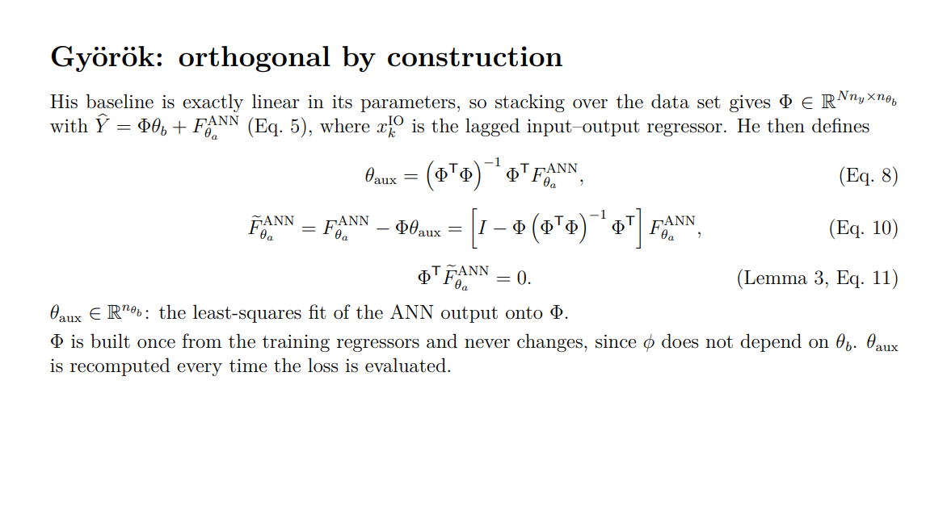
Notes:
Eq. 8 as a least-squares projection on sight

Slide 17
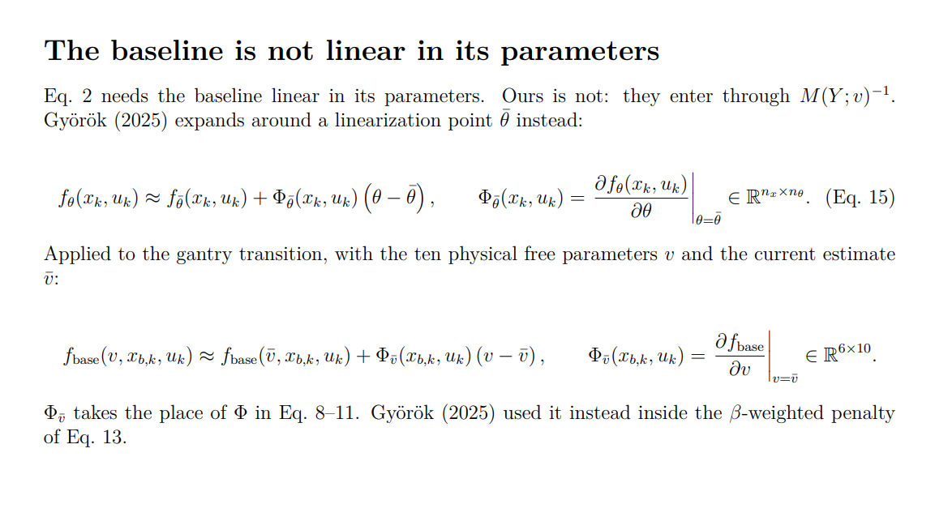
Notes:
The Y scheduling is not why Eq. 2 fails. Györök's phi is allowed to depend on the state and input however it likes, phi(x_k, u_k), so a Y-dependent regressor is perfectly admissible. Scheduling costs you nothing here.
What breaks Eq. 2 is that the parameters enter through the inverse: qddot = M(Y;v)^-1 (Pu - C(v) qdot - K(v) q), so the transition is rational in v. That would still be true with M constant and no scheduling at all. It is a property of second-order mechanical models, not of LPV.

Slide 18
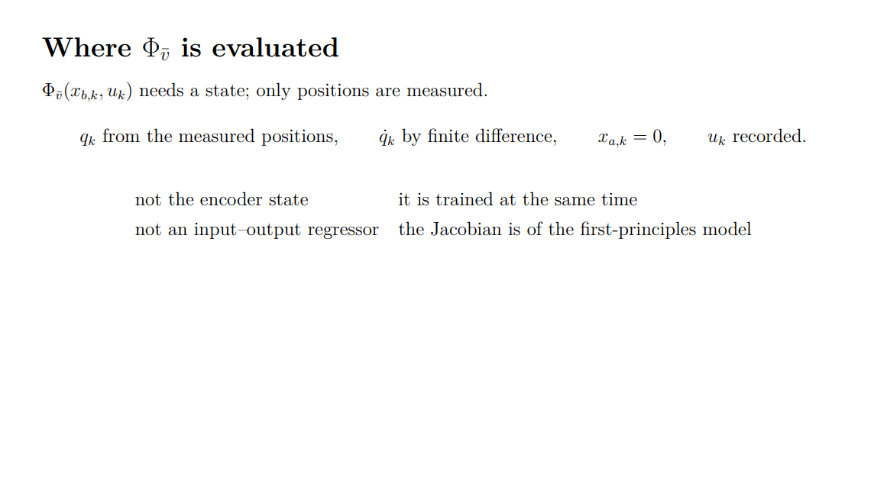
Notes:
The reconstructed state and recorded input are transformed to the same normalized coordinates used by the physical block. Two boundary samples per record are removed because the derivative stencil requires k ± 2.
Why not the encoder state? It changes while the ANN is trained. Why not an input–output regressor? The Jacobian is of the first-principles transition

Slide 19
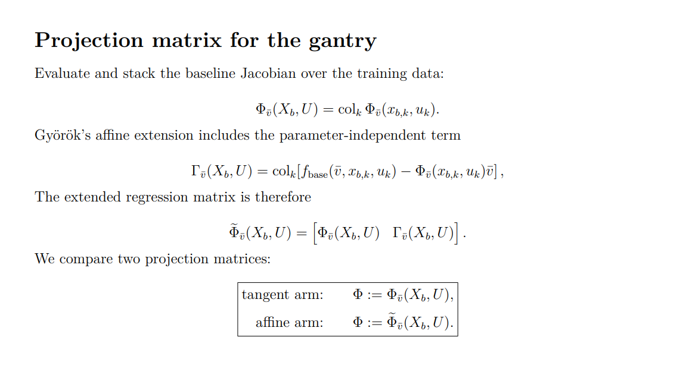

Slide 20
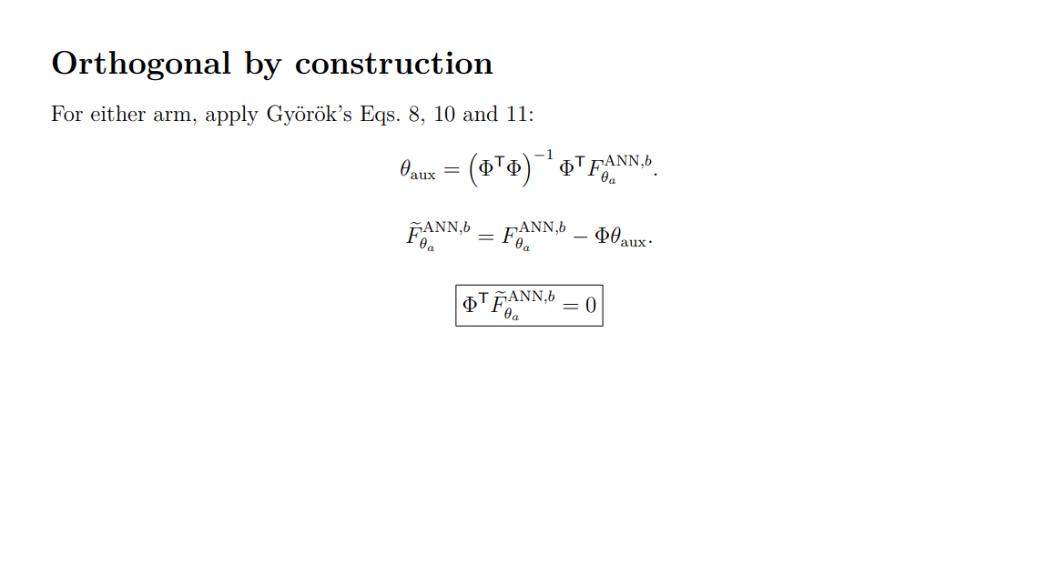

Slide 22
END ORTHOGONALITY DERIVATION.
START GYOROK OBC WHAT DID WE CHANGE

Slide 23
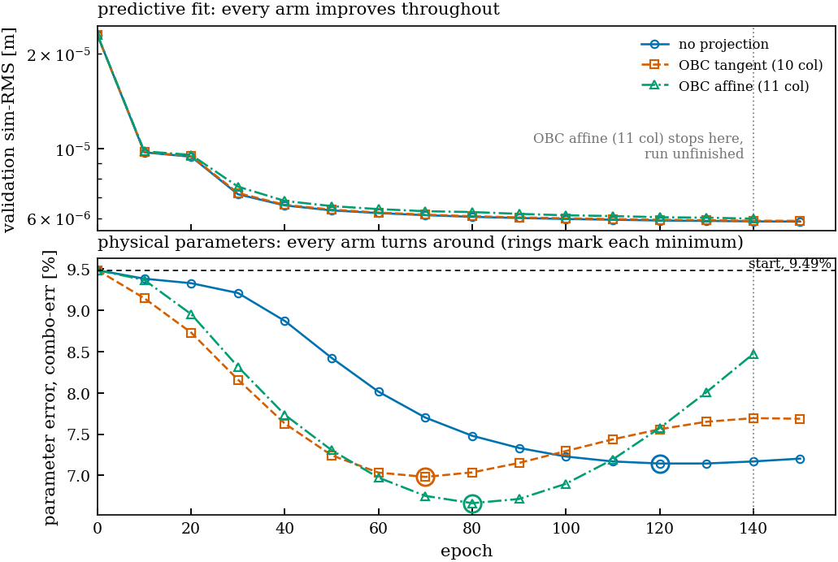

Slide 24
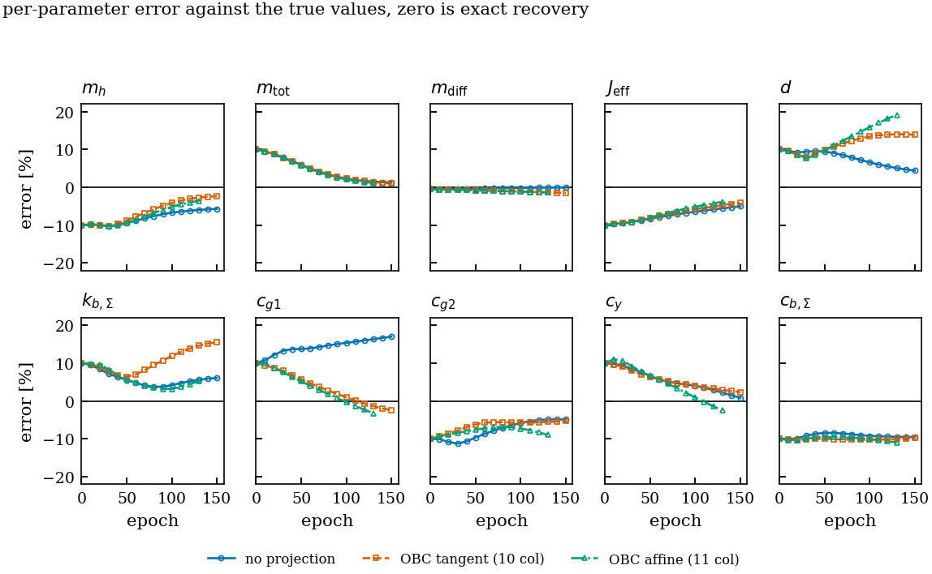

Slide 25
Question
Thesis formatting, any outline / guidelines?
  Amount of pages to aim for?

Slide 26
Thesis outline
Start writing
Sections
How many pages?
Kijken data genereren opzet geven zodat ik op basis daarvan conclusies ga trekken
  Include friction
  Bepalen met decisions how to outline thesis
  How many seeds, Montecarlo?
  Propose how I will quantify my method, look at Jan

Slide 27
Question
Currently detuning all parameter combinations with 10 percent instead of basing it off the data or the gantry specs.
Currently mismatch data / not fitted based on data
Real gantry system available measurements

Slide 28
Question
Currently not exciting the full band only around the added absorber, should I put a multisine over the entire band?
  100hz bandwidth controller. → will cancel multisine below that range
    Should I in that case move to the reference
  Motion profiles were able to capture full estimate, is that good enough?

Slide 29
Question
Can I just put noise directly on …
White noise?
Amount of db
I should propose something instead of asking
the same approach for noise as jan did

Slide 30
Feedback when for thesis
Determine date for feedback

Slide 31
Question
My supervisor Quinten will be in New Zealand during the presentation, do you have any advice for arranging the presentation taken this into account?

Slide 32
To do
Finish orthogonal by construction
Add noise

Slide 33
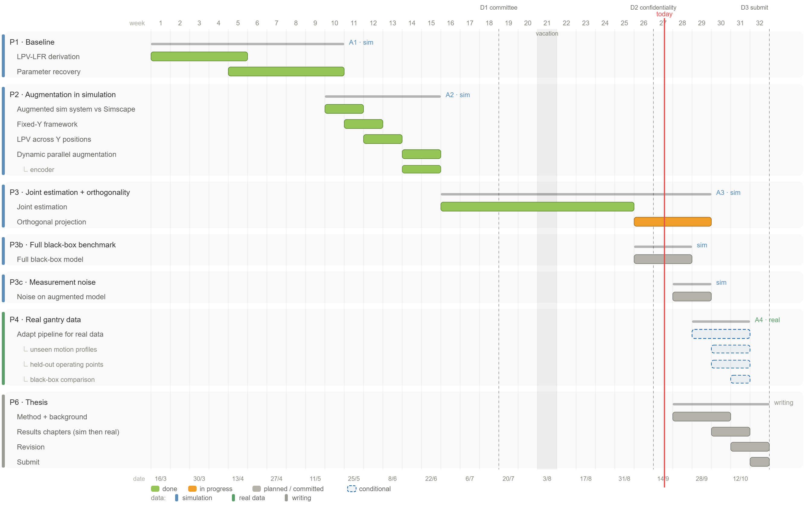

Slide 34
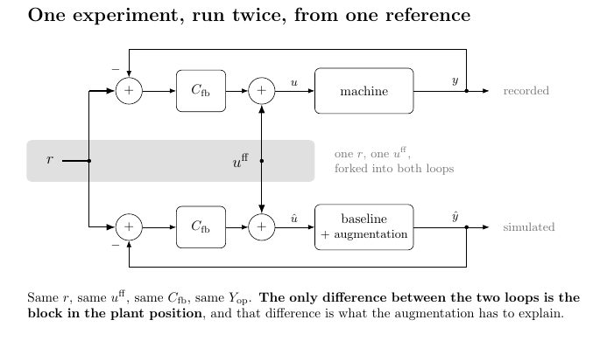
Notes:
Each simulation window we start with zero controller correction.
ŷ[k] = h(x[k]) <- model output at k, from the STATE only
e[k] = y[k] - ŷ[k]
u_fb[k]= Cc xc[k] + Dc e[k]
û[k] = u[k] + u_fb[k]x[k+1] = f(x[k], û[k]) <- û[k] produces ŷ[k+1], not ŷ[k]
xc[k+1]= Ac xc[k] + Bc e[k]
ŷ[k] is used to build û[k]; û[k] then moves the state forward and so determines ŷ[k+1]. It is not the same ŷ on both sides of the equal sign, it is k and k+1.
- Controller initial condition. xc = 0 at every window start.

Slide 35
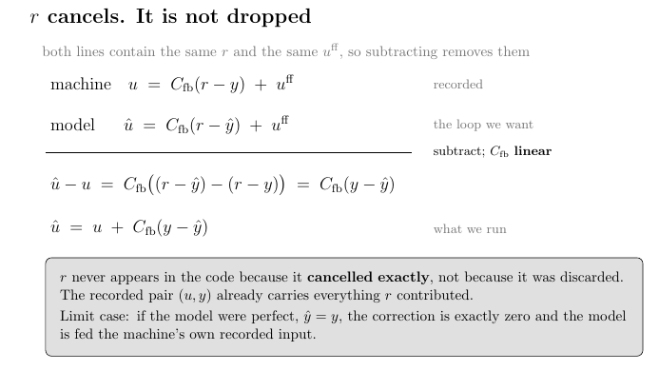
Notes:
Each simulation window we start with zero controller correction.
ŷ[k] = h(x[k]) <- model output at k, from the STATE only
e[k] = y[k] - ŷ[k]
u_fb[k]= Cc xc[k] + Dc e[k]
û[k] = u[k] + u_fb[k]x[k+1] = f(x[k], û[k]) <- û[k] produces ŷ[k+1], not ŷ[k]
xc[k+1]= Ac xc[k] + Bc e[k]
ŷ[k] is used to build û[k]; û[k] then moves the state forward and so determines ŷ[k+1]. It is not the same ŷ on both sides of the equal sign, it is k and k+1.
- Controller initial condition. xc = 0 at every window start.

Slide 36

Baseline model

Slide 37

System for data generation

Slide 38

Augmentation
Overview
Notes:
Kijken gaug is dat augmented states?

Slide 41
Ìmplement orthogonal by construction in State-Space for gantry
Györök | Gantry one-step extension
Input-output predictor | Physical state-transition model
Measured IO history is the regressor | Physical state is estimated by the fixed reference encoder
ANN correction is added to the output | ANN correction is added to the physical-state transition
Exact linear-in-parameter baseline \(\phi(x_k)\theta_b\) | Nonlinear RK4 transition
Exact regressor \(\phi(x_k)\) | Local parameter sensitivity \(J_{b,k}\)
Output-space projection | Normalized physical-state-space projection
No additional state rows | Additional-state rows have a zero baseline block
Fixed measured regressor matrix | Fixed full-training reference state set
Standard IO training assumptions | Partial state measurement, LPV scheduling and closed-loop training
Notes:
Györök
Gantry one-step extension
Input-output predictorPhysical state-transition model
Measured IO history is the regressorPhysical state is estimated by the fixed reference encoder
ANN correction is added to the outputANN correction is added to the physical-state transition
Exact linear-in-parameter baseline \(\phi(x_k)\theta_b\)Nonlinear RK4 transition
Exact regressor \(\phi(x_k)\)Local parameter sensitivity \(J_{b,k}\)
Output-space projectionNormalized physical-state-space projection
No additional state rowsAdditional-state rows have a zero baseline block
Fixed measured regressor matrixFixed full-training reference state set
Standard IO training assumptionsPartial state measurement, LPV scheduling and closed-loop training

Slide 42
Question
Should I use the encoder for the initialization of the orthogonality constraint?
  Only positions available, could differentiate them
  Encoder currently frozen from the baseline not updated each epoch

Slide 43
Main reason: why extend to orthogonal by construction
Current definition orthogonal to baseline for baseline parameters
  Tried to extend to prevent negation / additional states being separate , not affecting physical states
  Name solutions
Understand math to explain it well enough
  What is each matrix
Ask advice about the input-output to state space?

Slide 44
Closed loop checken excitation in closed-loop ipv open-loop
Kijken voor langere training window volledige run?

Slide 45
Maarten and Roland mailen
  Worked it out in state space from input output
  Ask about linearization point for LPV; Y scheduling ?
  Solve phi not full rank by combining parameters? Same as in joint estimation?
  Bring op issue with additional state routing into the y^hat but we don’t constrain the additional states with current orthogonality definition.
Issues
  Linear in model. We have nonlinear LPV scheduling in Y
  Not full rank regressor phi, need to combine parameters
    Look into jacobian one step then?? Since implementation is also NARX?
  Closed loop simulation with training will affect the statistics or at least bias them
  Theorems not to be reevaluated especially with the controller bias
  Encoder?

Slide 46
Goal of email
state I converted input-output to state space
Added additional state, maybe show the resulted formula. And that with that definition we are orthogonal. But also show how the recurrent additional state dynamics can work back in.
State what I currently want to work on. Like the linearization point or another approach.
My parameters are not full rank, so I will combine some, similar like how I combined parameters for the parameter estimation approach/method. Im thinking maybe use jacobian here instead. Not sure if worth mentioning?
Need to extend theory to controller for the simulation part, for input it does not matter.
Dear all,
I have currently converted Bendegúz his orthogonal by construction from input-output to state space by adding a delayed state and .. To the state-space notation. I have also added the additional state to it, and by the definition of orthogonality of: …
it is orthogonal to the baseline.
But then for the recurrent affect (show what I mean with indirectly affecting and not orthogonalizing) Orthogonality of accumulated output effects I will leave out for the thesis scope.
Would it be possible to get feedback on this current direction?
The current approach is not worked out for the scheduling variable for my LPV system (Y in this case). And if I take a linearization point for taylor expansion similar to Bendegúz his regularization approach or another method.
Do you recommend working out his theorems, for example my plant is marginally stable and this is outside of his theorem 10/constraint (not sure what this was)

Slide 47
$${\overset{ˆ}{y}}_{k}=φ\left(s_{k},u_{k}\right)θ_{b}+g_{y,η}\left(s_{k},u_{k},x_{a,k}\right),$$
$$x_{a,k}⟶g_{y,η}⟶{\overset{ˆ}{y}}_{k}⟶s_{k+1}.$$
$$s_{k+1}=As_{k}+B_{u}u_{k}+B_{x}{\overset{ˆ}{y}}_{k},$$
$$x_{a,k+1}=g_{a,η}\left(s_{k},u_{k},x_{a,k}\right).$$
“Here, \(s_k\) contains the delayed inputs and outputs, and \(x_{a,k}\) contains the additional learned states. \(A\) shifts the history, while \(B_u\) and \(B_x\) insert the current input and predicted output. The ANN correction \(g_y\) now depends on the additional states, and \(g_a\) computes their next value from the current history, input and additional states.”

Slide 48
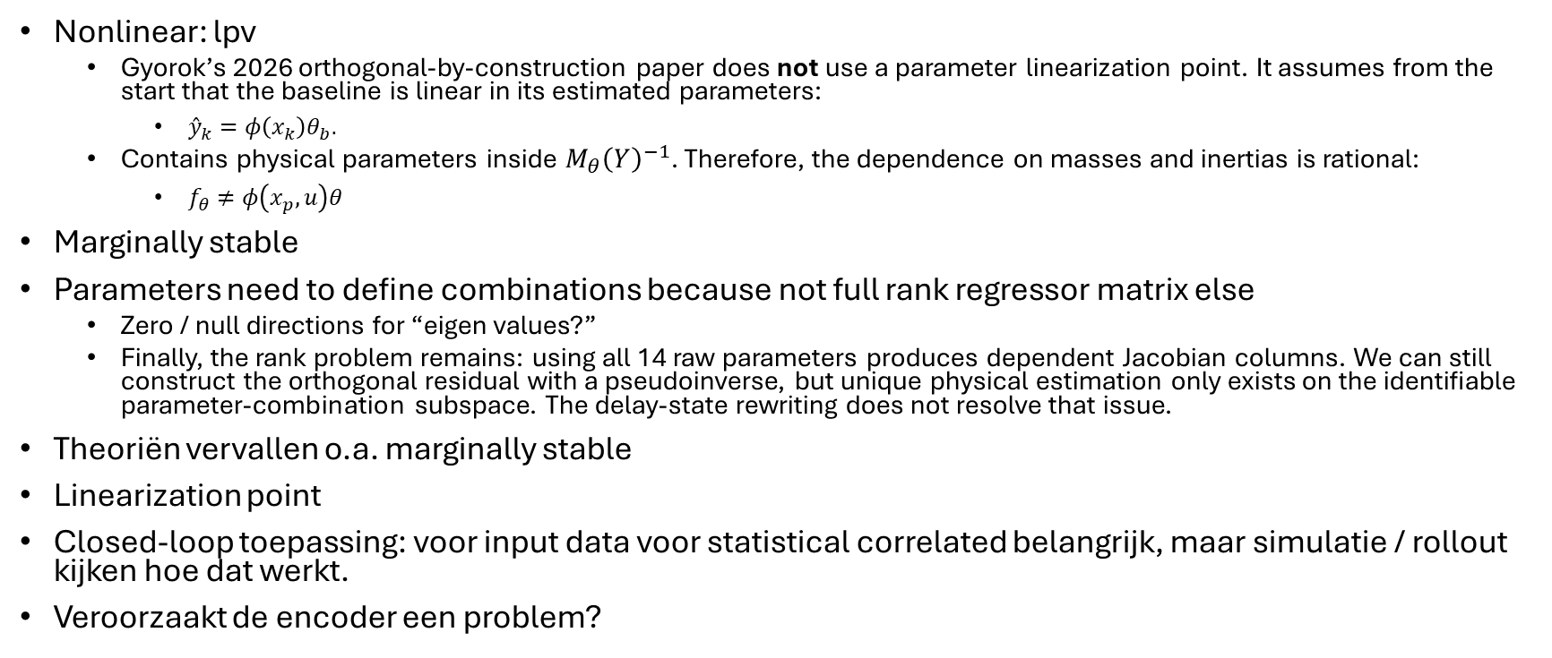
Orthogonal by construction
Issues
Nonlinear: lpv
  Gyorok’s 2026 orthogonal-by-construction paper does not use a parameter linearization point. It assumes from the start that the baseline is linear in its estimated parameters:
    ${\overset{ˆ}{y}}_{k}=φ\left(x_{k}\right)θ_{b}.$
  Contains physical parameters inside $M_{θ}{\left(Y\right)}^{−1}$. Therefore, the dependence on masses and inertias is rational:
    $f_{θ}≠φ\left(x_{p},u\right)θ$
Marginally stable
Parameters need to define combinations because not full rank regressor matrix else
  Zero / null directions for “eigen values?”
  Finally, the rank problem remains: using all 14 raw parameters produces dependent Jacobian columns. We can still construct the orthogonal residual with a pseudoinverse, but unique physical estimation only exists on the identifiable parameter-combination subspace. The delay-state rewriting does not resolve that issue.
Theoriën vervallen o.a. marginally stable
Linearization point
Closed-loop toepassing: voor input data voor statistical correlated belangrijk, maar simulatie / rollout kijken hoe dat werkt.
Veroorzaakt de encoder een problem?

Slide 49
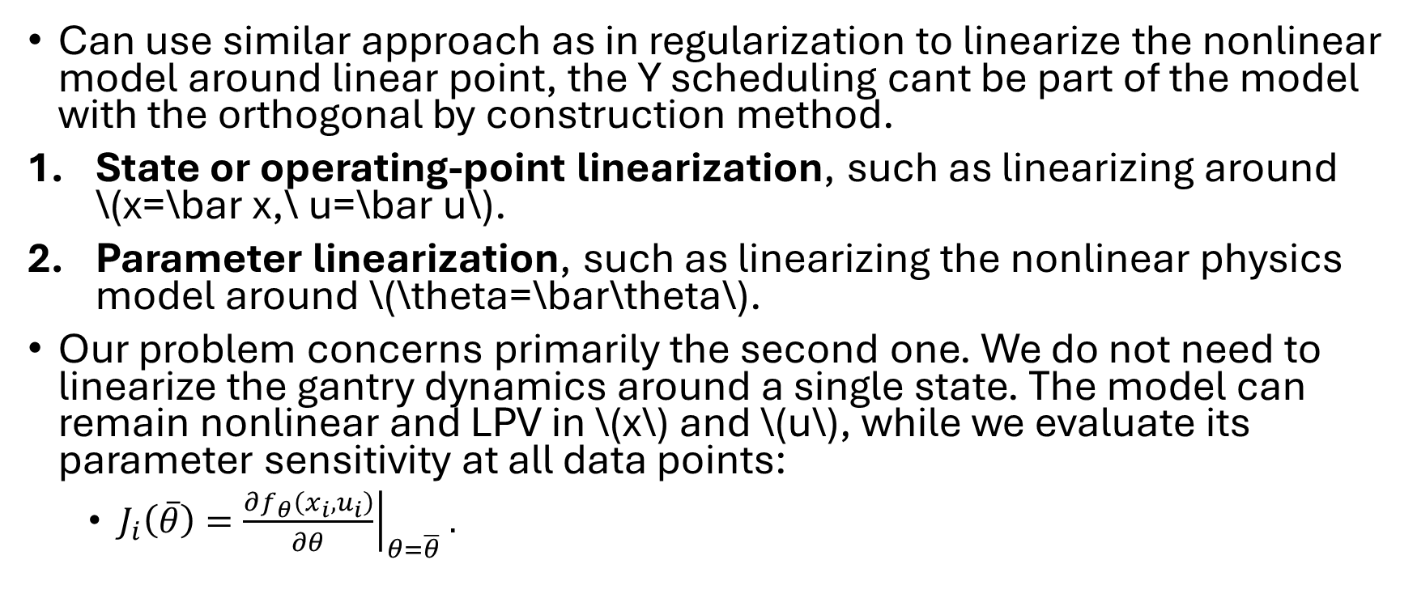
Linearization issue
Can use similar approach as in regularization to linearize the nonlinear model around linear point, the Y scheduling cant be part of the model with the orthogonal by construction method.
State or operating-point linearization, such as linearizing around \(x=\bar x,\ u=\bar u\).
Parameter linearization, such as linearizing the nonlinear physics model around \(\theta=\bar\theta\).
Our problem concerns primarily the second one. We do not need to linearize the gantry dynamics around a single state. The model can remain nonlinear and LPV in \(x\) and \(u\), while we evaluate its parameter sensitivity at all data points:
  $J_{i}\left(\overline{θ}\right)={\left.\frac{∂f_{θ}\left(x_{i},u_{i}\right)}{∂θ}\right|}_{θ=\overline{θ}}.$

Slide 50
Orthogonality for one step vs over rollout
Thus the thesis can safely state:
The additional-state update is orthogonal to the physics baseline under the defined one-step augmented-state inner product because the physics model has zero contribution in those coordinates.
It must then add:
This does not imply orthogonality of the output effects produced by the additional states after dynamic propagation.

Slide 51
Jacobian to define identifiable parameters?
Currently not a clean algebraic derivation
If for joint estimation we can use the jacobian like one sample next step?
  Need to make sure it matches gyorok his approach. Maybe that is cleaner then what I currently have in lpv_lfr_baseline

Slide 52
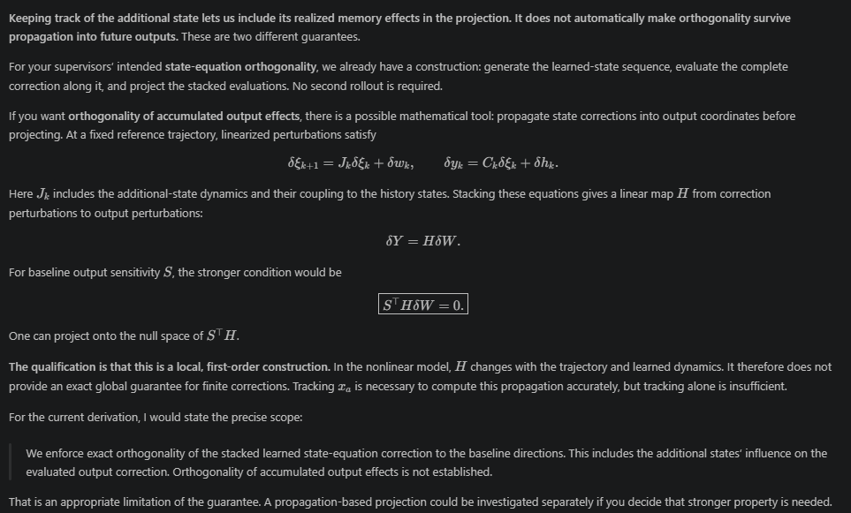
Recurrent problem additional states:
Orthogonality of accumulated output effects
Orthogonal to innerproduct:
I would also change “the latent-update parameters are uncharged.” The additional-state rows contribute zero directly to the inner product. But parameters of the encoder and \(g_a\) can affect the evaluated \(G_y\) through the latent recursion; if we differentiate through that recursion and projection, those dependencies participate in training.
Keeping track of the additional state lets us include its realized memory effects in the projection. It does not automatically make orthogonality survive propagation into future outputs. These are two different guarantees.
For your supervisors’ intended state-equation orthogonality, we already have a construction: generate the learned-state sequence, evaluate the complete correction along it, and project the stacked evaluations. No second rollout is required.
If you want orthogonality of accumulated output effects, there is a possible mathematical tool: propagate state corrections into output coordinates before projecting. At a fixed reference trajectory, linearized perturbations satisfy
\[ \delta\xi_{k+1}=J_k\delta\xi_k+\delta w_k, \qquad \delta y_k=C_k\delta\xi_k+\delta h_k. \]
Here \(J_k\) includes the additional-state dynamics and their coupling to the history states. Stacking these equations gives a linear map \(H\) from correction perturbations to output perturbations:
\[ \delta Y=H\delta W. \]
For baseline output sensitivity \(S\), the stronger condition would be
\[ \boxed{S^\top H\delta W=0.} \]
One can project onto the null space of \(S^\top H\).
The qualification is that this is a local, first-order construction. In the nonlinear model, \(H\) changes with the trajectory and learned dynamics. It therefore does not provide an exact global guarantee for finite corrections. Tracking \(x_a\) is necessary to compute this propagation accurately, but tracking alone is insufficient.
For the current derivation, I would state the precise scope:
We enforce exact orthogonality of the stacked learned state-equation correction to the baseline directions. This includes the additional states’ influence on the evaluated output correction. Orthogonality of accumulated output effects is not established.
That is an appropriate limitation of the guarantee. A propagation-based projection could be investigated separately if you decide that stronger property is needed.

Slide 53
Meeting Outline
Last week
  Closed-loop training
    Main issue was not a big enough error between system and baseline for the additional states
      Additional states learning
  Longer training runs
    More complex neural network and more additional states → no real benefit
  L-BFGS
  Transient issue
Orthogonality regularization
  Implemented Györök’s approach
    Required changes
    Does not include additional states
  Suggestions for extending Györök’s framework for additional states
    → Advised against instead to look to orthogonal by construction
Notes:
I’ll go a bit over Gyorok his paper and how I expand on it for the routing only through the physical states.
Currently it is not capable of penalizing the additional states, I have some suggestions for extending that and would prefer getting feedback on that.

Slide 54
System Error not big enough?
MSD payload mass previously: 10% and 90% respectively
For the following images 50%-50% split, and the excitation amplitude scaled 5x, taking the input force from 4.4e+01 N to 2.2e+02 N RMS on X1/X2 and 3.6e+01 N to 1.4e+02 N on Y.
Notes:
Force ratio is not 5x across the dataset. It ranges 0.98x to 5.07x.- Standstills and Y-sweeps: ~5.0x on X, ~3.75x on Y (T1-T7, V1, V3, E2)- APRBS and lissajous: 1.2x to 2.9x- E4_multisine_off: 1.00x, unchangedBecause AMP_SCALE scales the excitation, not the total input. On a standstill the force is almost pure excitation so it scales ~5x; on an APRBS record the trajectory-following force dominates and barely moves.
Net effect on the absorber displacement, which is what the augmentation has to learn: 2.19e-05 m to 3.17e-05 m, a factor 1.45, because the mass-fraction change worked against the amplitude change.

Slide 55
Todo
Test arm with additional state
Text for results ses
Run with actual proposed additional state orthogonality addition

Slide 56
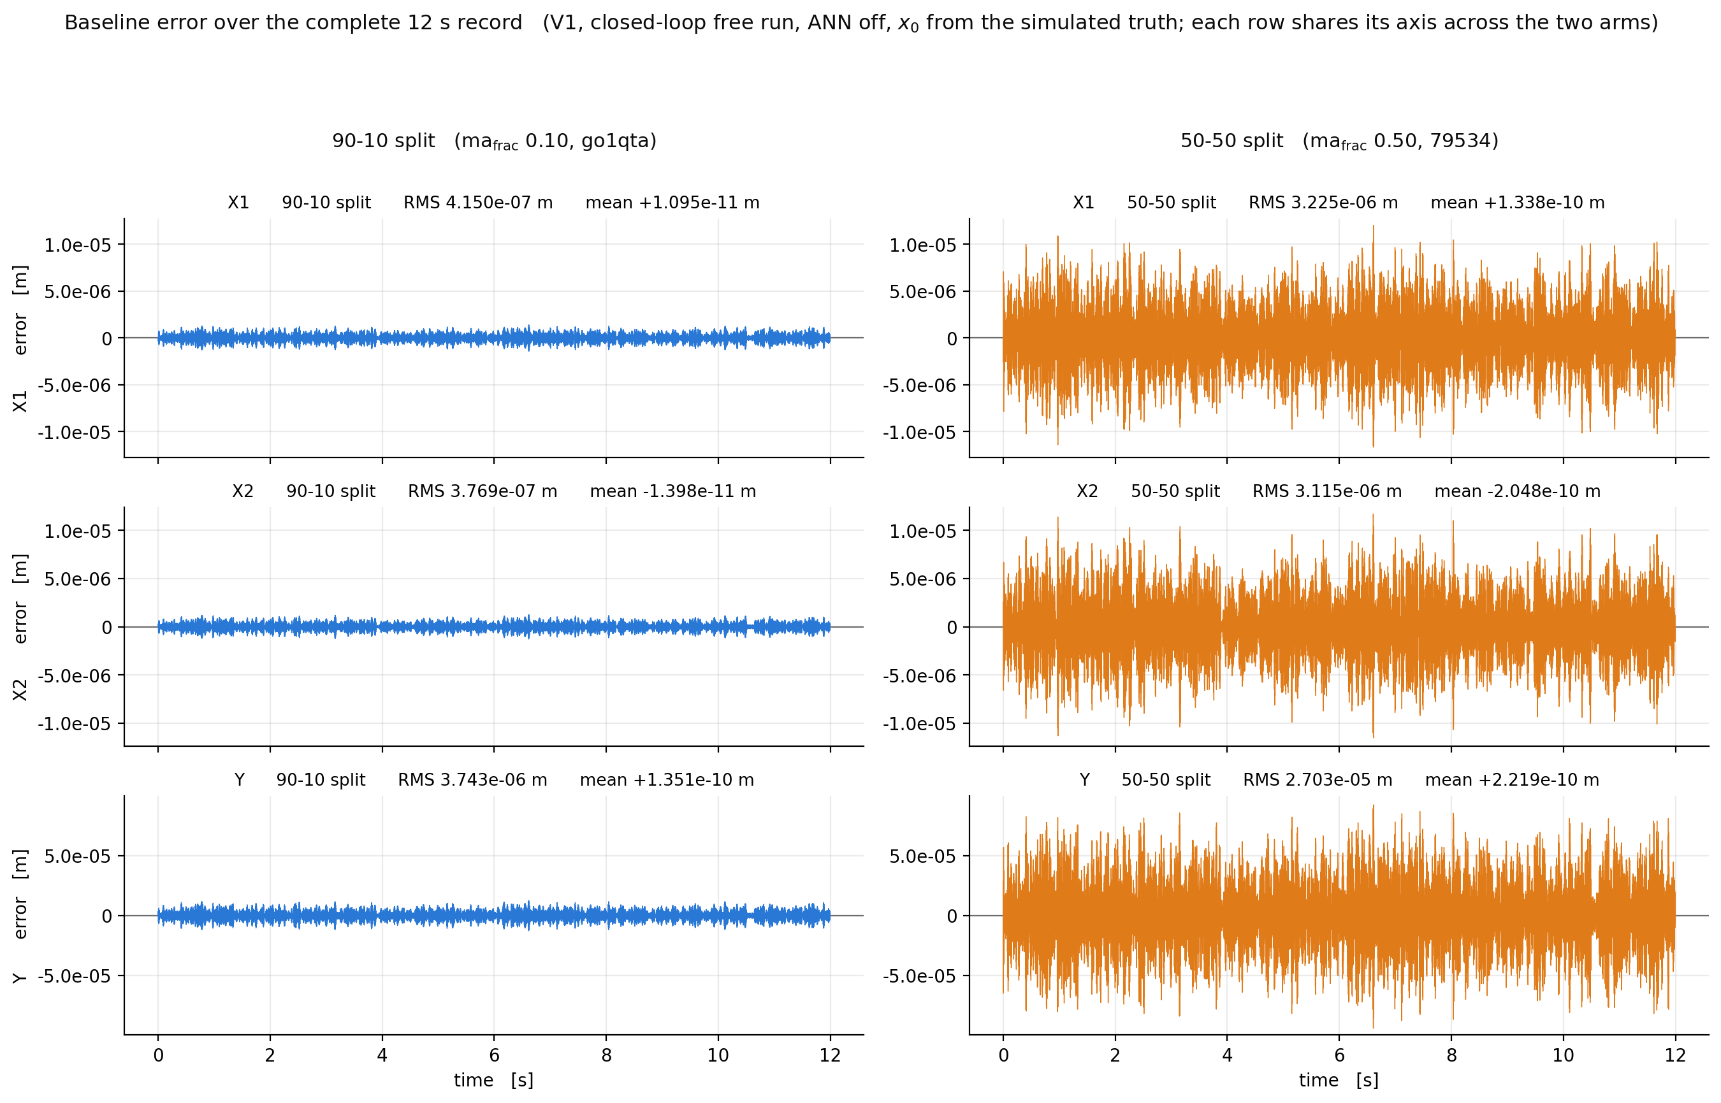

Slide 57
New setup – Dynamics moved
With the 50-50 split the resonance moved
New multisine band now spans:
  140 to 230 Hz

Slide 58
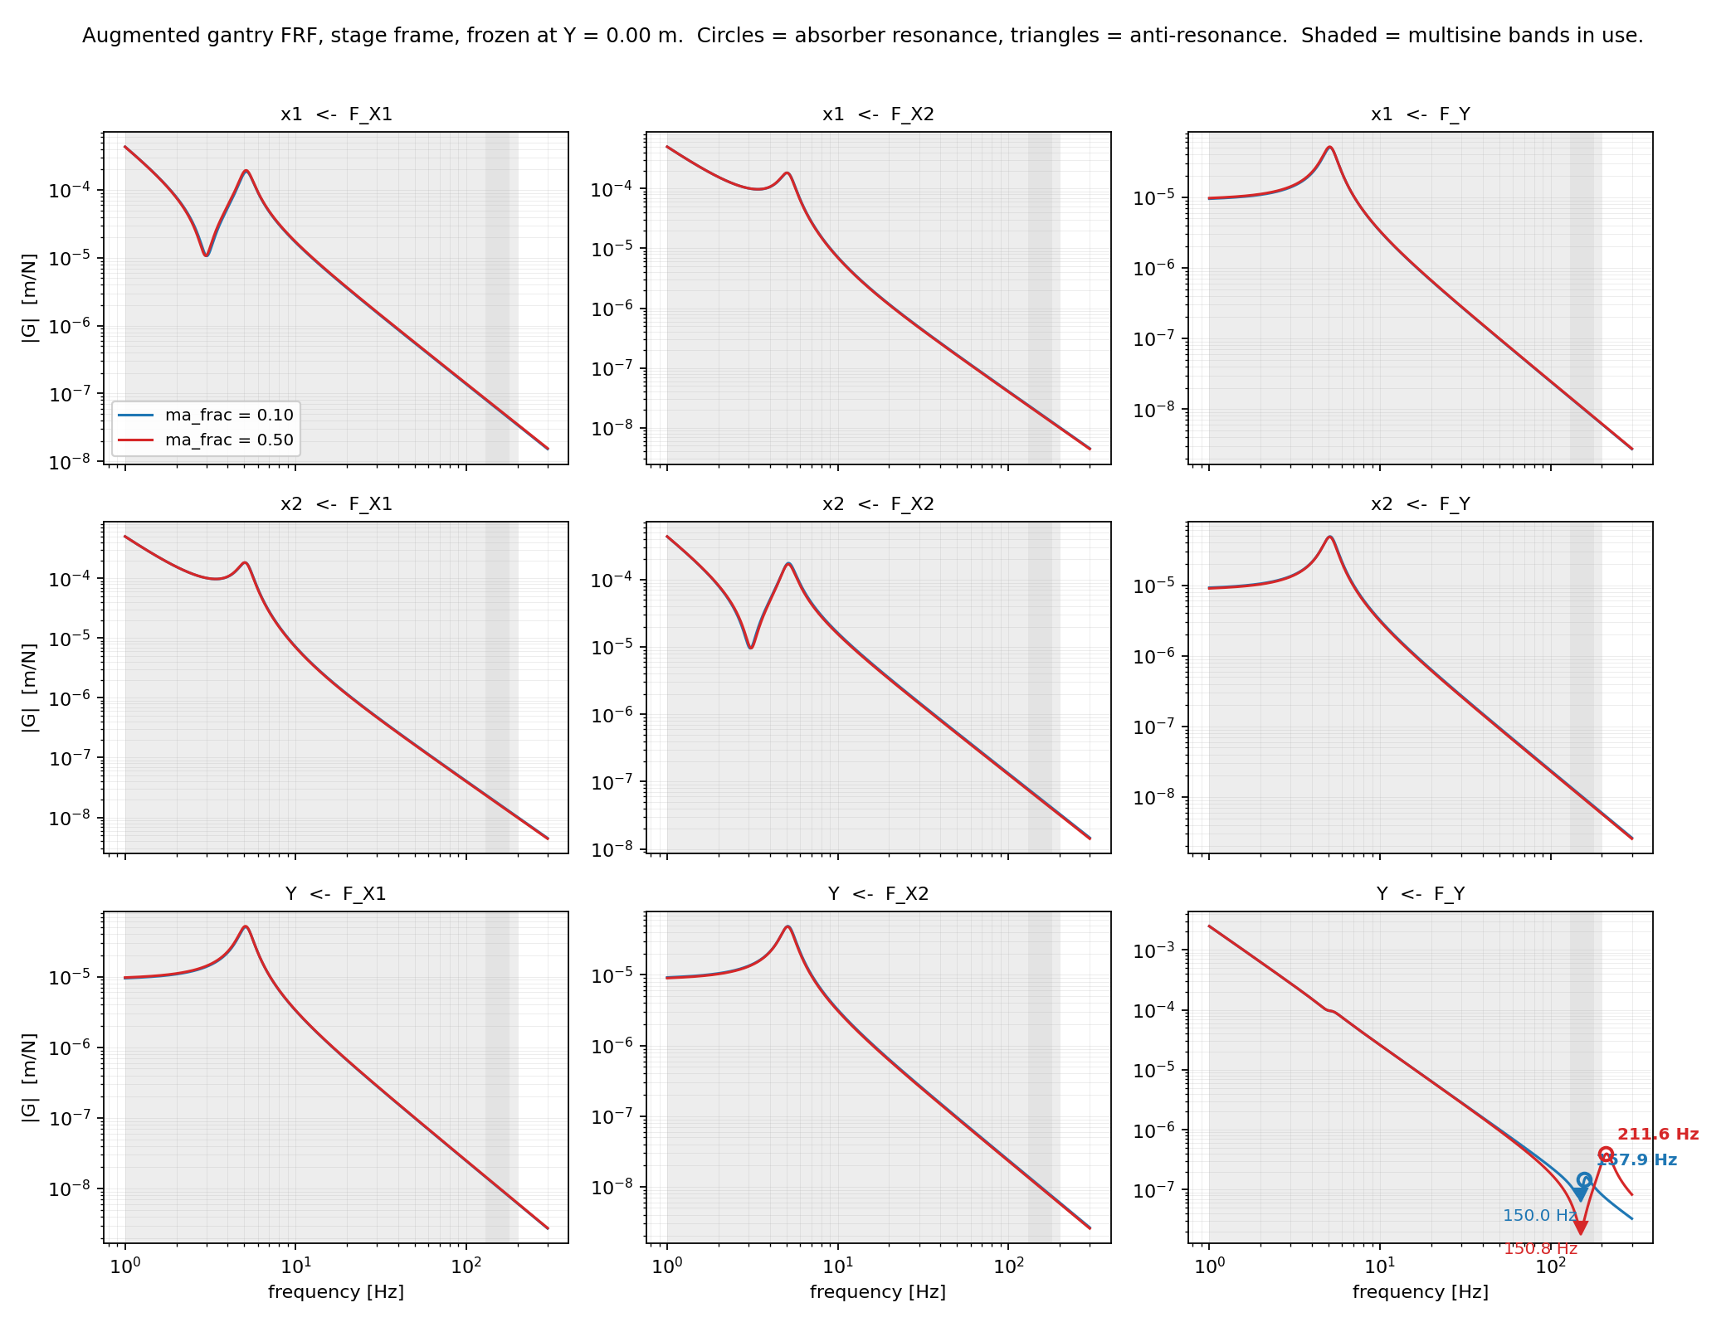

Slide 59
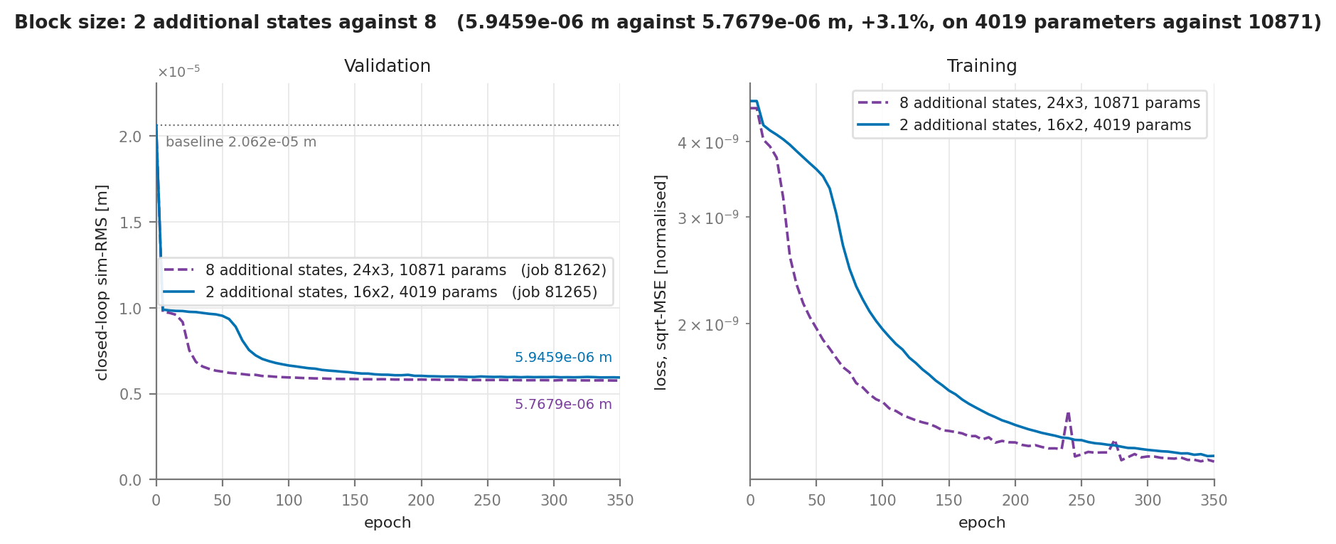
Capturing missing dynamics
2 vs 8 additional states

Slide 60
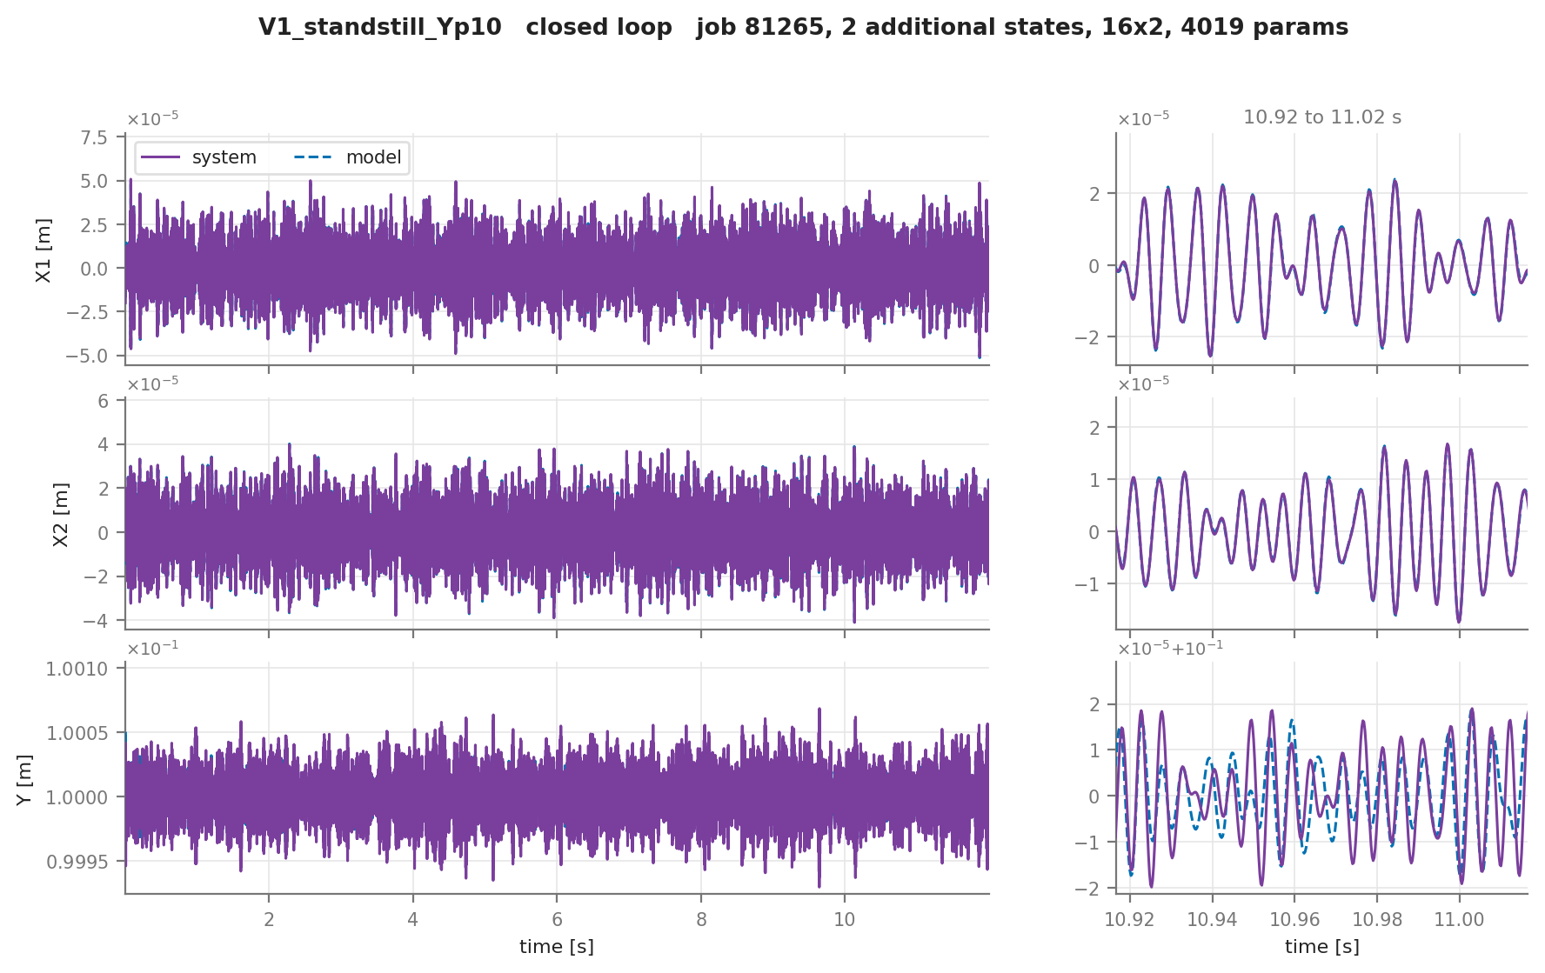

Slide 61
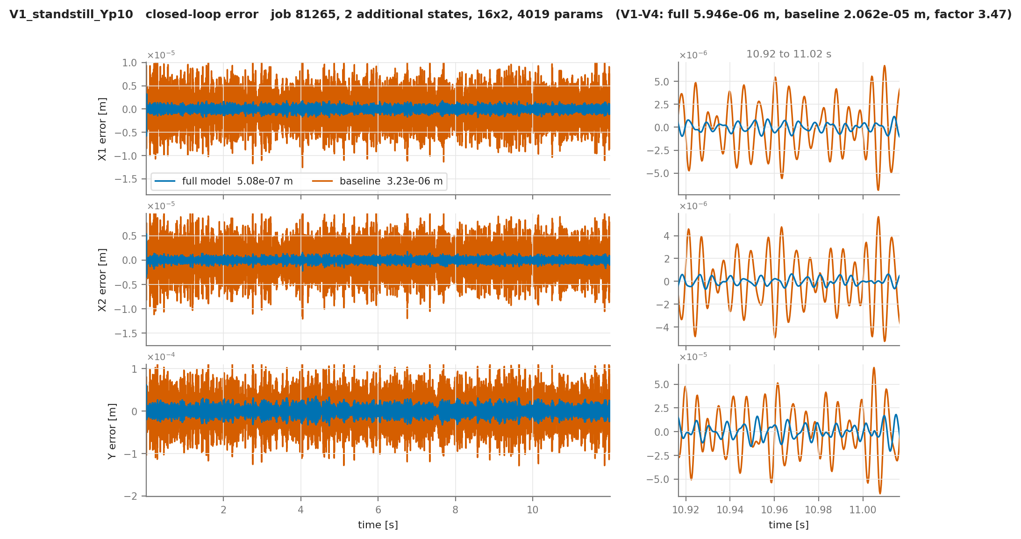

Slide 62
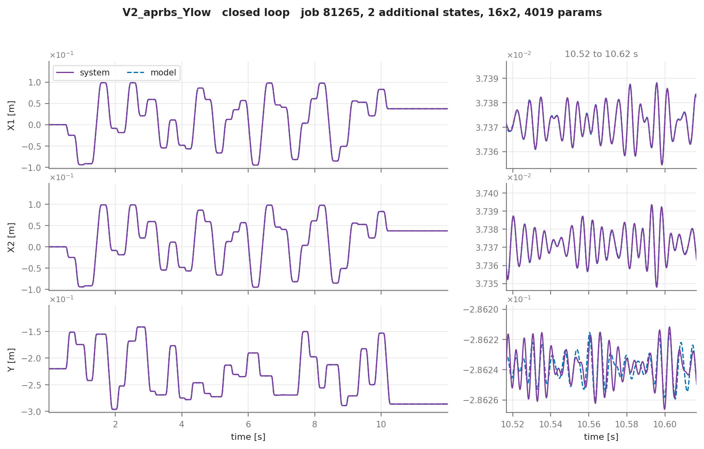

Slide 64
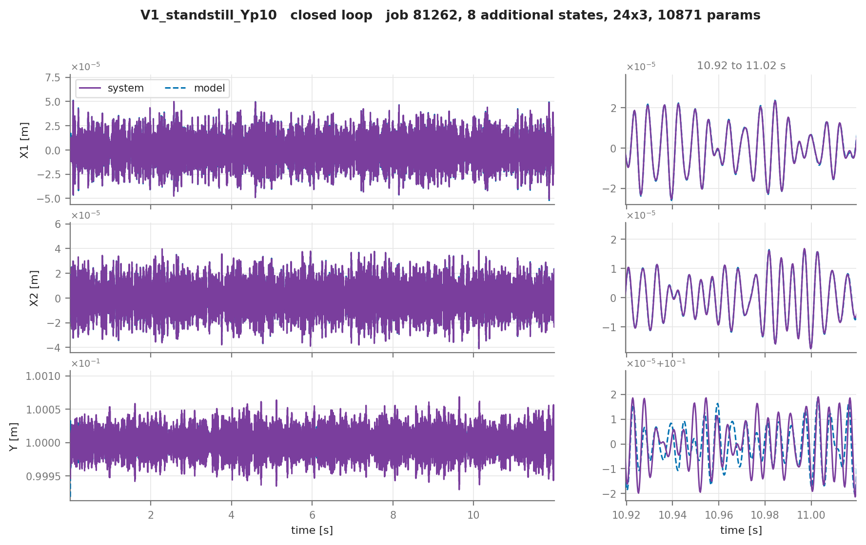

Slide 65


Slide 67
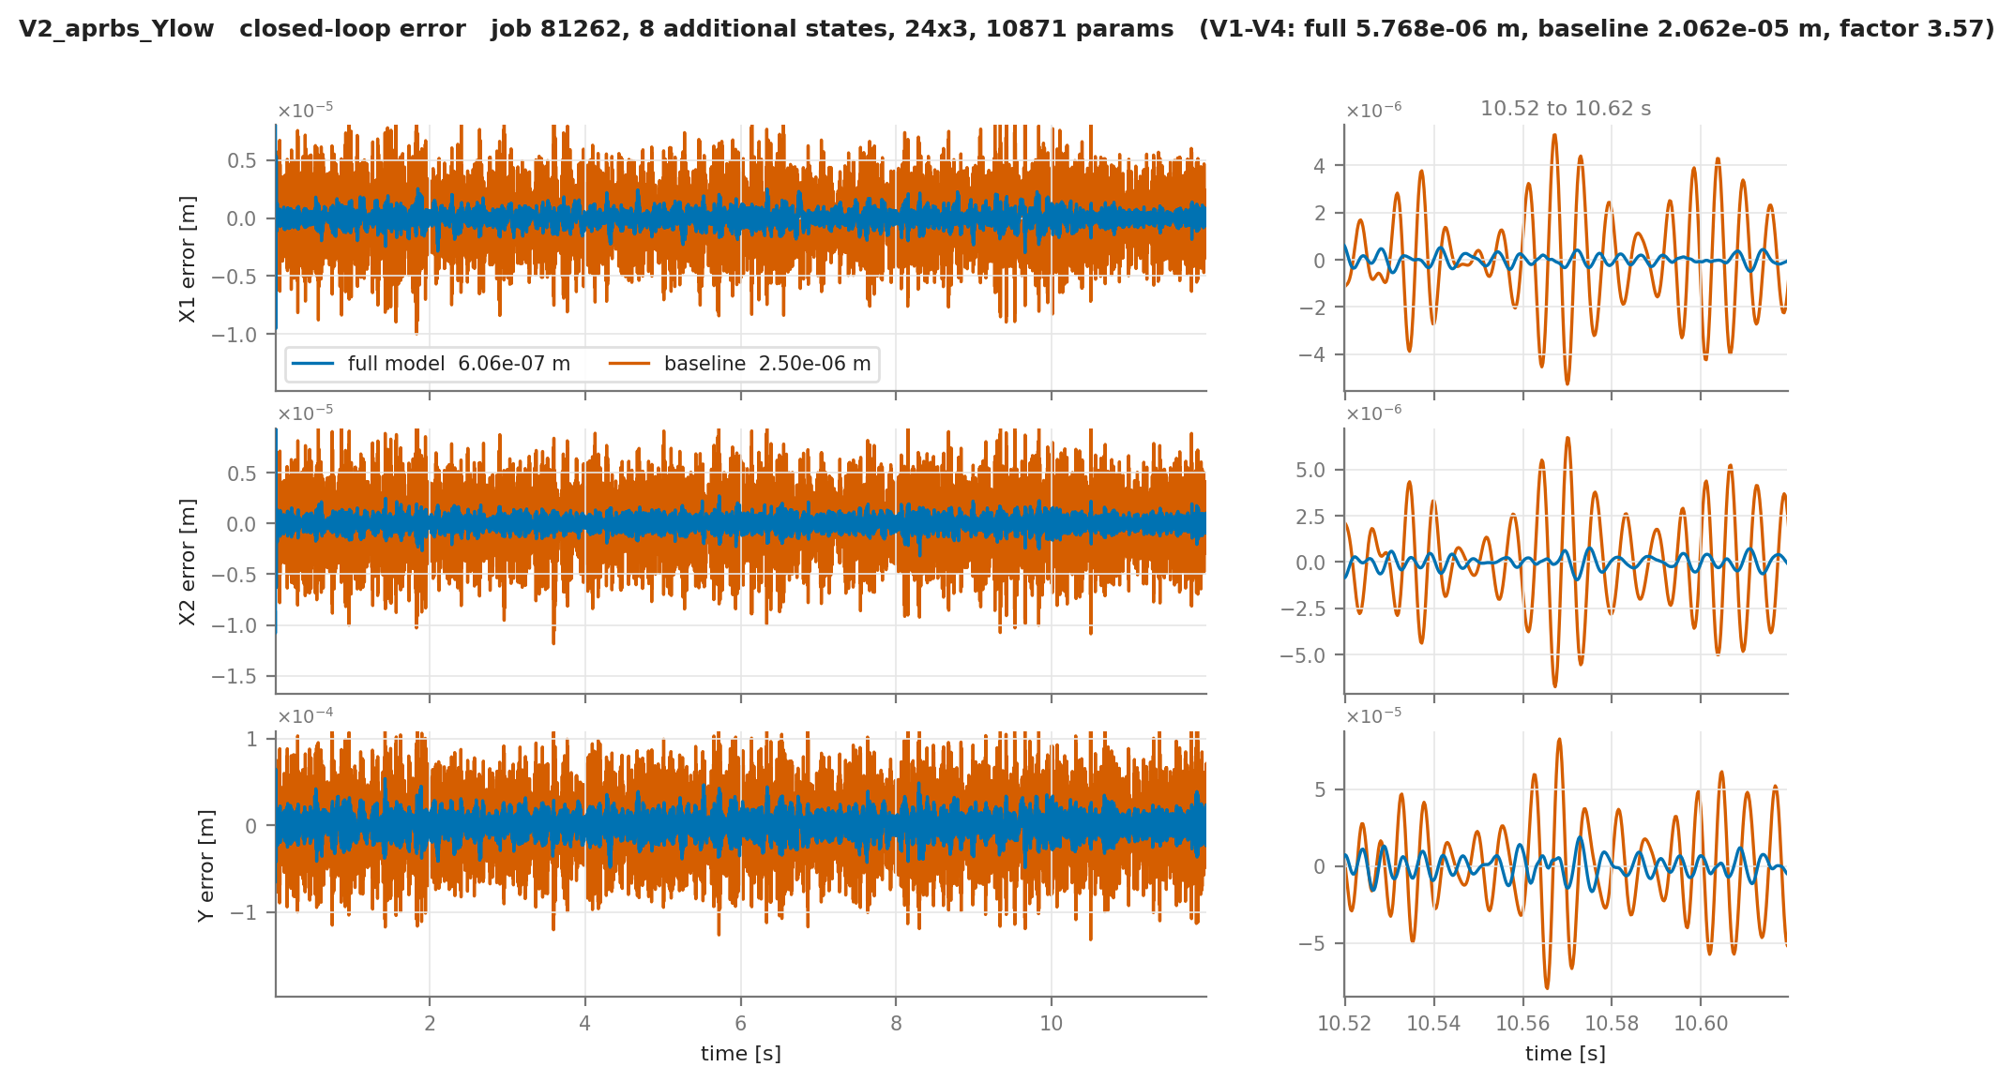

Slide 68
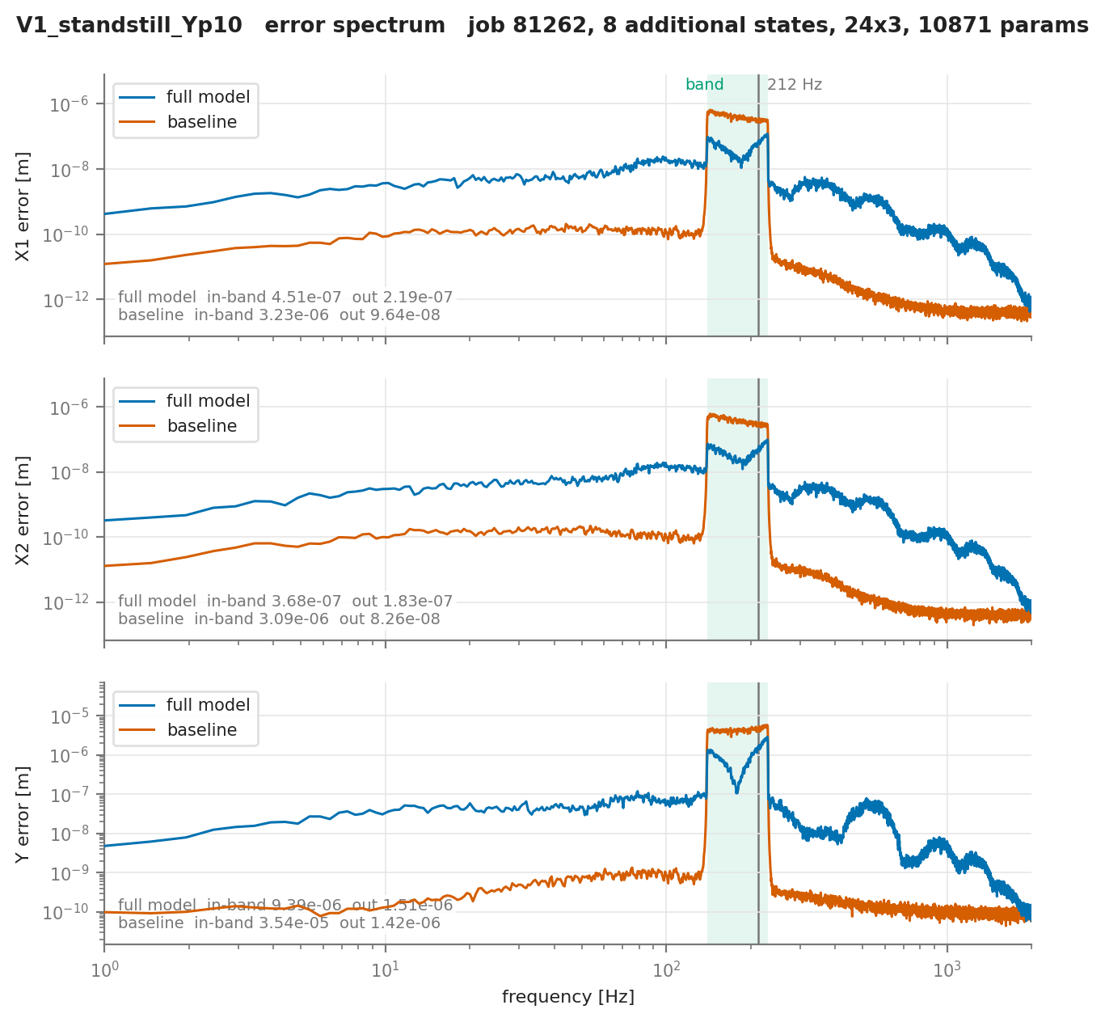
Model
Currently only multisine excitation around the resonance from the absorber excited

Slide 69
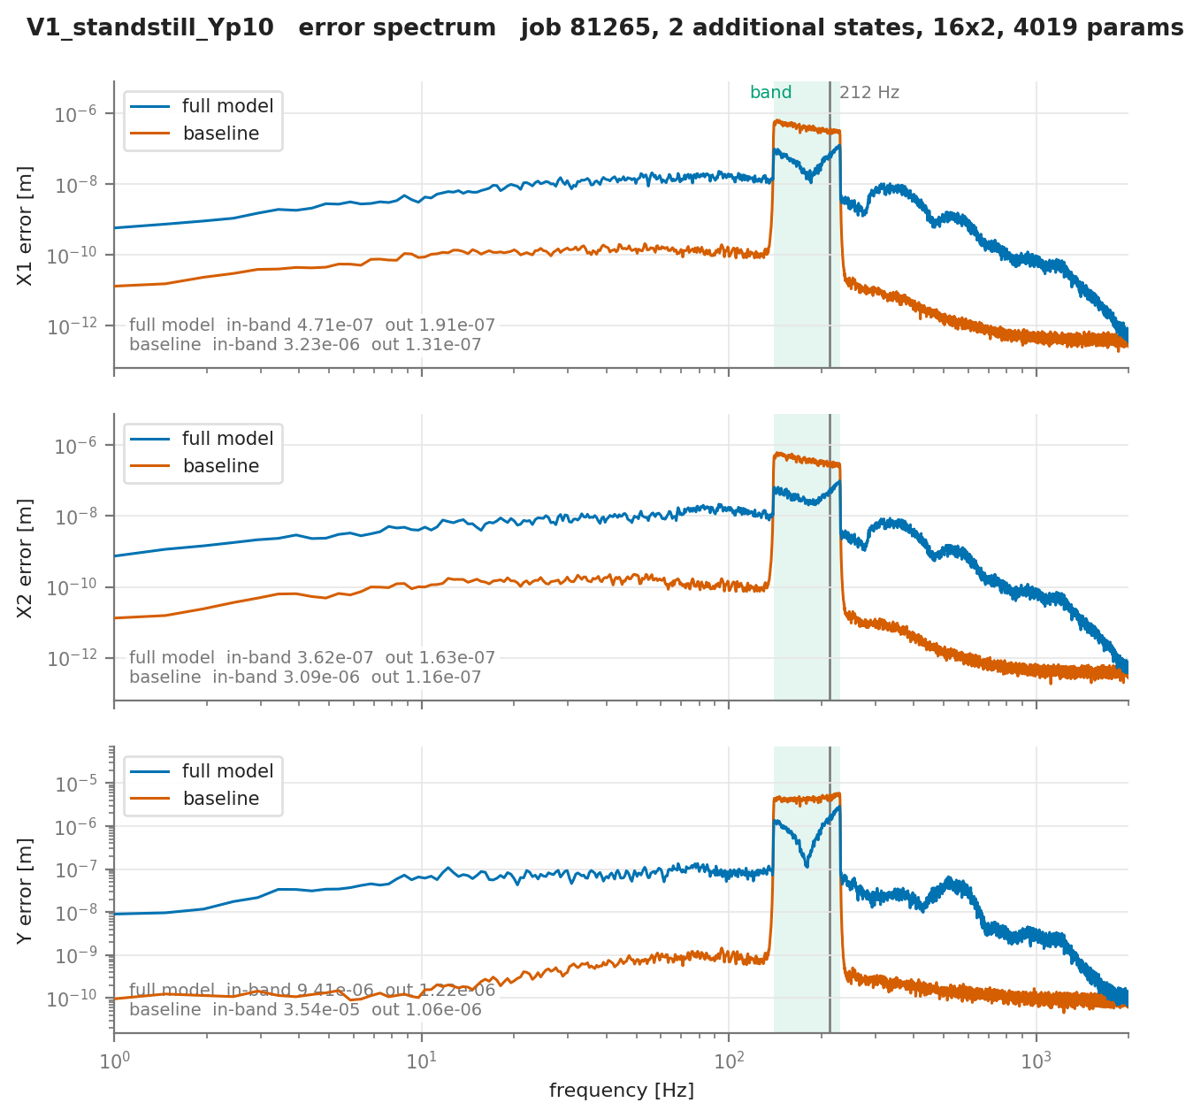

Slide 70
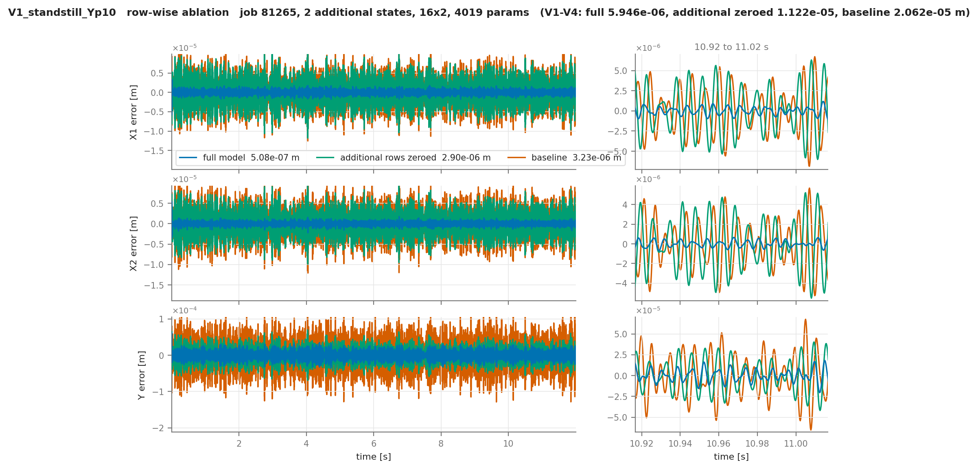
Additional states learning

Slide 72
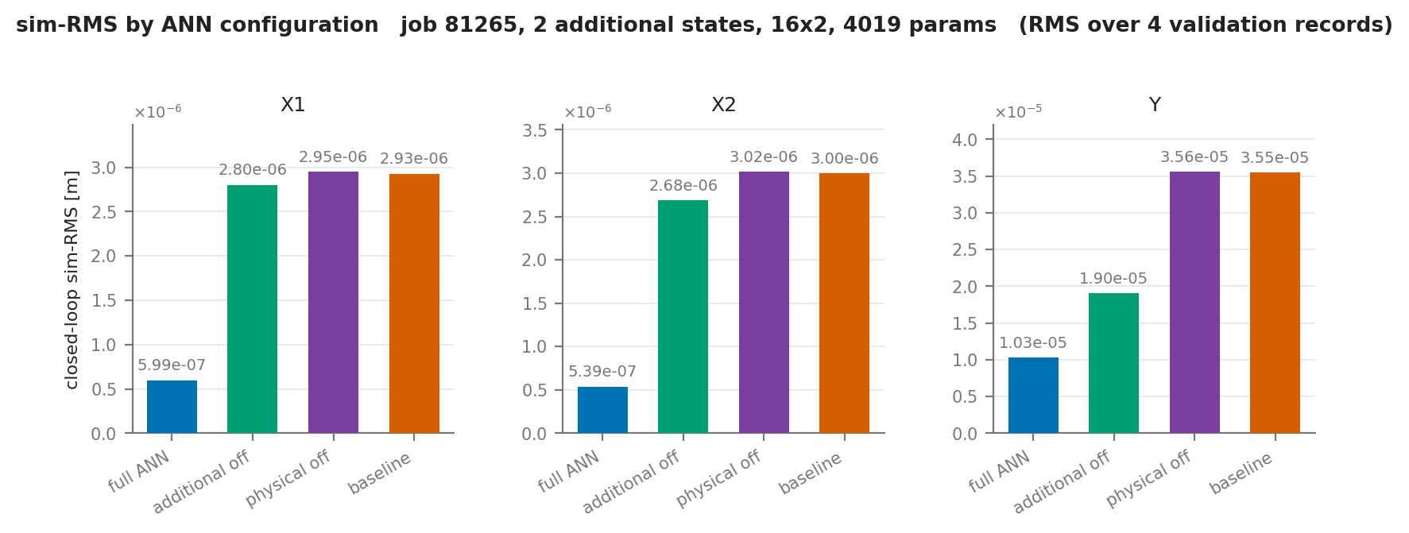

Slide 73
Quasi-newton
L-BFGS
Run after adam optimizer
L-BFGS is useful to get the last percentages
Adam takes small fixed-size steps and doesn't know the shape of the valley it's in
L-BFGS estimates that shape from the last x gradients, so it knows which way is downhill and how far to go
That's useless far from the optimum, and very effective near it
  Making it good at squeezing out the last few percentages
Notes:
After Adam, not instead of it: Adam explores, the quasi-Newton phase converges.
- One fixed batch of 16384 windows, held constant for the whole phase, because a fresh minibatch each iteration would break both the curvature estimate and the line search.
- All parameters in one vector, m = 50 stored pairs, strong-Wolfe line search.
- The result is kept only if it improves the closed-loop validation; otherwise the weights are restored exactly.

Slide 74
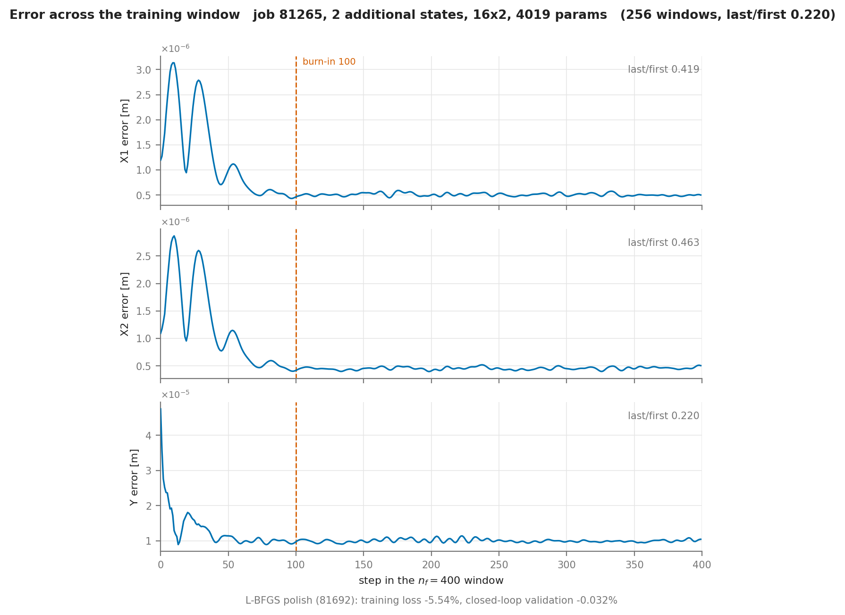
Transient error

Slide 76
Transient: Error is focused in the first samples
Encoder biased?
Does training prioritize the encoder initialization and due to the loss prevents us from learning the missing dynamics?
Mismatch between 12s validation and the 0.1s windows: validation only one encoder initialization over 12s
  → Initial state becomes less important
Proposed “burn in” → don’t include the first x amount of samples in the loss

Slide 77
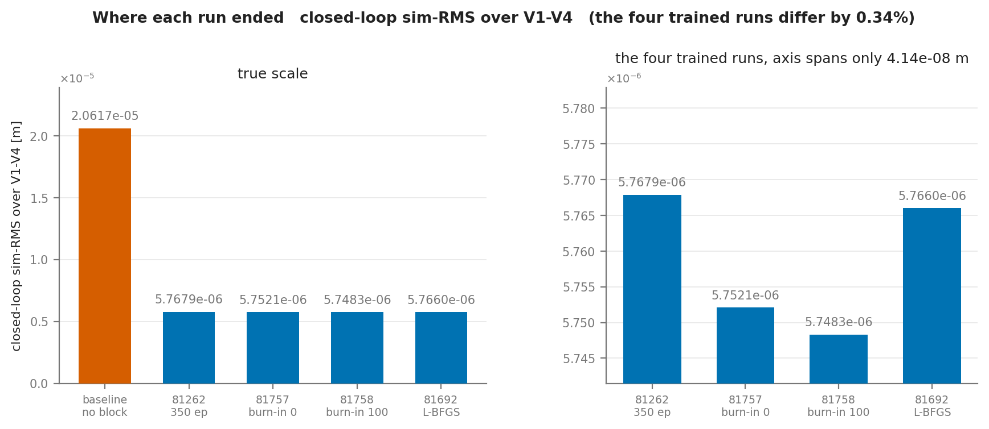
Notes:
│ step │ change │ share │
│ 81262 → 81757 (50 more epochs, no burn-in) │ −0.274% │ 81% │
│ 81757 → 81758 (burn-in 100 instead of 0) │ −0.066% │ 19% │
│ 81262 → 81758 (total) │ −0.339% │ 100% │
│ run │ iterations │ closure evals │ wall │ loss before → after │ outcome │
│ 81757 (burn-in 0) │ 12 │ 27 │ 466 s │ 1.180768e-09 → 1.137518e-09 │ accepted │
│ 81758 (burn-in 100) │ 13 │ 28 │ 512 s │ 1.042195e-09 → 1.040041e-09 │ rolled back │

Slide 78
Question
Not realistic simulation data
For if I don’t get to work on the real data due to time limit I should make the current setup more difficult besides noise.
Nonlinear → Add cubic spring
Would adding friction only in the simulation be a good idea?
The 50-50 mass split is not realistic perse, but I need a “big enough” error if I want the additional states to learn
  (Not the ANN correction to the existing physical states)

Slide 79
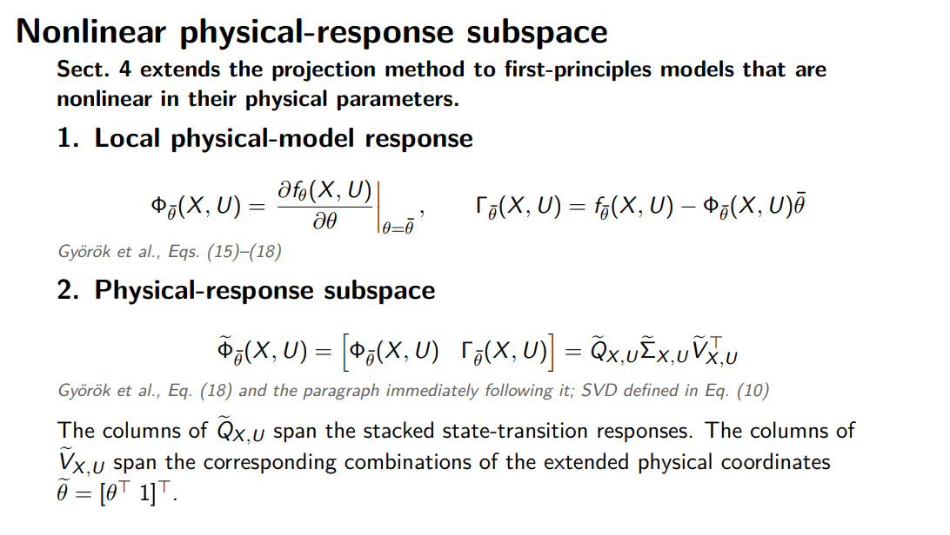
Notes:
f: the physical model’s state-transition function. Take the taylor approximation with respect to that, Gamma is the affine offset
Phi: The paper calls this per-sample Jacobian \(\Phi_{\bar\theta}(x_k,u_k)\). Across \(N\) operating points it is stacked vertically:
For each parameter J(x0,u0)
Each column therefore represents the complete sampled state-transition response caused by changing one physical parameter:
For a baseline nonlinear in \(\theta\), the paper replaces \(\Phi\) with the Jacobian-based local approximation.
That makes the result local to the chosen \(\bar\theta\) and sampled \((X,U)\); it is not a global orthogonality guarantee.
What is \(\Gamma\)?
Rearrange the Taylor approximation:
\(Q\) is an orthonormal basis for the physical-response subspace represented by the regressor matrix.
$${\tilde{Φ}}_{\overline{θ}}\left(X,U\right)=\left[\begin{matrix}Φ_{\overline{θ}}\left(X,U\right) & Γ_{\overline{θ}}\left(X,U\right)\end{matrix}\right],$$
$$Φ_{\overline{θ}}\left(X,U\right)=\left[\begin{matrix}{\left.\frac{∂f_{θ}\left(x_{0},u_{0}\right)}{∂θ}\right|}_{\overline{θ}} \\ ⋮ \\ {\left.\frac{∂f_{θ}\left(x_{N−1},u_{N−1}\right)}{∂θ}\right|}_{\overline{θ}}\end{matrix}\right],$$
which contains the physical parameter sensitivities, and
$$Γ_{\overline{θ}}\left(X,U\right)=\left[\begin{matrix}f_{\overline{θ}}\left(x_{0},u_{0}\right)−Φ_{\overline{θ}}\left(x_{0},u_{0}\right)\overline{θ} \\ ⋮ \\ f_{\overline{θ}}\left(x_{N−1},u_{N−1}\right)−Φ_{\overline{θ}}\left(x_{N−1},u_{N−1}\right)\overline{θ}\end{matrix}\right],$$
which contains the affine offset of the Taylor approximation.
They are combined so the nonlinear physical model can locally be written as a linear multiplication:
$$F_{θ}\left(X,U\right)≈{\tilde{Φ}}_{\overline{θ}}\left(X,U\right)\left[\begin{matrix}θ \\ 1\end{matrix}\right].$$
Your model cannot be written that way exactly. So Györök's Section 4 locally linearizes with respect to the parameters, not the state:
fθ​(X,U)≈fθˉ​(X,U)+∂θ∂fθ​(X,U)​​θˉ​(θ−θˉ).
Define
$$Φ_{\overline{θ}}\left(X , U\right)={\frac{∂f_{θ}\left(X , U\right)}{∂θ}∣}_{\overline{θ}}.$$
Then rearrange:
fθ​≈Φθˉ​θ+Γθˉ​fθˉ​−Φθˉ​θˉ​​.
What does $Φ_{\overline{θ}}$mean?
Each column answers approximately:
“If I perturb this physical parameter, what pattern of change does the physical state transition produce over all the selected operating points?”
Why is $Γ$needed?
This is easy to explain incorrectly.
$$Γ_{\overline{θ}}=f_{\overline{θ}}−Φ_{\overline{θ}}\overline{θ}$$
is the affine offset of the local Taylor approximation.
If the physical model had been linear in parameters, you would simply have
$$f_{θ}=Φθ.$$
But after linearizing a nonlinear parameterization you obtain an affine model:
fθ​≈Φθ+Γ.
Györök therefore introduces the extended coordinate
θ=[θ1​]
WHY THIS SLIDE EXISTS
Gyorok's Eq. 9 needs f = Φθ, linear in the parameters.
Ours is not: the mass matrix is rational in the masses.
Sect. 4 is his own fix for exactly that case.
Φ AND Γ = first-order Taylor of f around θ̄
f_θ ≈ Φ_θ̄ · θ + [ f_θ̄ − Φ_θ̄ θ̄ ]
this bracket is Γ
Φ_θ̄ = what the physics can CHANGE.
Column i = how the predicted next state moves if parameter i moves.
6 rows per sample, 14 columns. Stacked: 134400 x 14.Γ_θ̄ = what the physics ALREADY DOES at θ̄. No θ in it. One column.
Stacked: 134400 x 1.Together [Φ | Γ] times θ̃ = [θ ; 1] recovers the linear form of Eq. 9.That is the whole trick: a nonlinear baseline made linear in an extendedparameter vector.
THE SVD (Φ̃ = Q̃ Σ̃ Ṽᵀ, so 134400 x 15)
Q̃ columns: directions in PREDICTION space the baseline can produce.
Ṽ columns: the PARAMETER combinations that produce them.
Σ̃: how strongly each combination shows up in this data.
IF ASKEDWhy keep Γ at all: without it we protect only directions reached byCHANGING parameters, not the baseline's own response.A tiny σ with its Ṽ column = a parameter combination the data cannot see.We have four of those, at 1e-18: kb1−kb2, cb1−cb2, Jb−Jh, and a mass split.So Q̃ is truncated, not all 15 columns. Slide 2 fixes θ̄ = θ0.

Slide 80
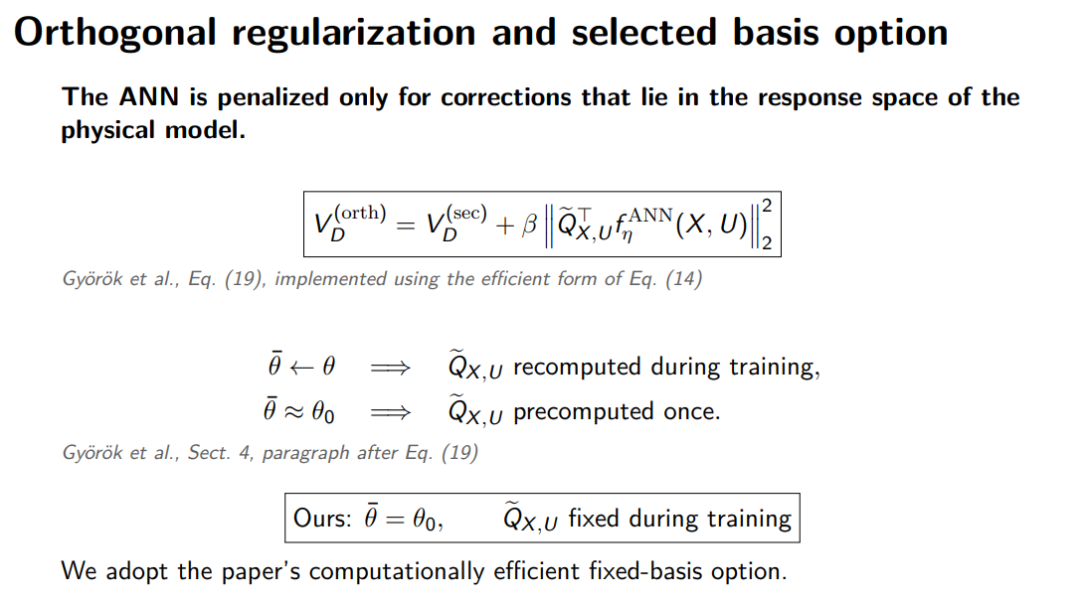
Notes:
• V(sec) = the loss we already minimise.
We add additional penalty for the orthogonality
It measures the squared size of the ANN component that overlaps with the physical model.
$${\tilde{Π}}_{X,U}=QQ^{⊤}.$$
$$β{\left\|{\tilde{Π}}_{X,U}f_{η}^{ANN}\left(X,U\right)\right\|}_{2}^{2.}$$
$$f_{η}^{ANN}=\underset{\text{parallel to physical responses}}{\underbrace{QQ^{⊤}f_{η}^{ANN}}}+\underset{\text{orthogonal discrepancy}}{\underbrace{\left(I−QQ^{⊤}\right)f_{η}^{ANN}}}.$$
$$V^{\left(orth\right)}=V^{\left(sec\right)}+β{\left\|\underset{\text{physical−like ANN behavior}}{\underbrace{QQ^{⊤}f_{η}^{ANN}}}\right\|}_{2}^{2.}$$
A small notation distinction:
\(\widetilde{\Phi}_{\bar\theta}\): nonlinear physical regressor/sensitivity matrix.
\(Q\): orthonormal basis obtained from its SVD.
\(\widetilde{\Pi}_{X,U}=QQ^\top\): projection matrix constructed from that basis.
So \(\widetilde{\Phi}\) describes the physical responses, while \(\widetilde{\Pi}\) performs the projection.
It measures the squared size of the ANN component that overlaps with the physical model.
Currently this is done with detuned parameters, instead of obtaining the parameters from the data.
SAY — WHAT THE TWO TERMS ARE
• V(sec) = the loss we already minimise.
Take a window.
Encode x̂₀ from past measurements.
Roll the model 400 steps forward with the controller closed around it.
Compare predicted output to measured output using mean squared error.
“sec” = sections: the paper splits the data into overlapping subsections.
• β‖Q̃ᵀ f_ANN(X,U)‖² = the new term.
Evaluate the ANN on the FIXED point set from the previous slides.
Project its output onto the physical response space.
Square that projection.
This measures the part of the ANN correction that could instead have been produced by the physical parameters.
β controls how strongly we penalise that overlap.
WHY Q̃ᵀ AND NOT Q̃Q̃ᵀ?
• Q̃ has orthonormal columns.
• Therefore:
‖Q̃Q̃ᵀf‖² = ‖Q̃ᵀf‖²
• So they give exactly the same penalty.
• Computationally:
Q̃ᵀf requires only 15 dot products.
Q̃Q̃ᵀ would involve a 134,400 × 134,400 projector.
• This is an identity, not an approximation.
THE CHOICE ON THIS SLIDE
• θ̄ = the point around which the Taylor expansion was taken on the previous slide.
• Option 1: θ̄ ← θ
The basis follows the current physical parameters.
Requires a new Jacobian and SVD every evaluation.
• Option 2: θ̄ = θ₀
Build the basis once before training.
Keep it fixed during training.
This is what we do.
• Paper’s argument:
θ₀ comes from physics.
If θ₀ is sufficiently close to the true parameters, the basis remains valid.
• So the fixed-basis approach is the paper’s efficient option, not a shortcut introduced by us.
WHAT IT BUYS US
• Φ̃ never depends on the ANN.
• Therefore the basis requires only one precomputation.
• The penalty gradient reaches only the ANN.
• Physical parameters and encoder are updated through V(sec) alone.
• Verified experimentally:
Their gradients are bit-identical with β switched on and off.
IF ASKED — COMPUTATIONAL COST
• Recomputing the basis would require:
One Jacobian.
One SVD.
At every update.
• That would happen roughly 6,500 times per training arm.
IF ASKED — IS θ₀ CLOSE ENOUGH?
• In the paper:
θ₀ is a datasheet-based prior.
• In our case:
θ₀ is deliberately detuned by 10%.
• Therefore our fixed basis is potentially “staler” than in the paper’s setting.
• We have not measured how much this affects the validity of the basis.
IF ASKED — DIFFERENCE IN LOSS FUNCTION
• Our V(sec):
400-step prediction loss.
Closed-loop rollout.
Initial state obtained from the encoder.
• Paper:
15-step cost.
Uses measured initial states.
IF ASKED — WHY β DOES NOT TRANSFER FROM THE PAPER
• Our orthogonality penalty is an unnormalised sum over 134,400 rows.
• V(sec) is averaged.
• Therefore the two terms have very different numerical scales.
• β consequently absorbs both:
The desired strength of the orthogonality constraint.
The scale mismatch between the two loss terms.
• Therefore the paper’s β value cannot be transferred directly.

Slide 81
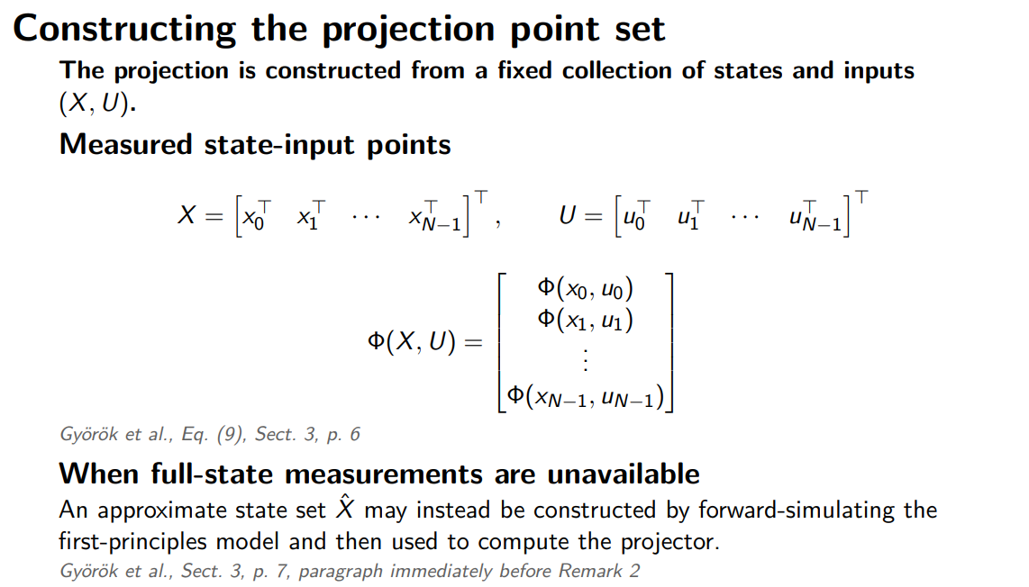
Notes:
SAY — WHERE (X,U) COMES FROM
• Slides 1 and 2 used (X,U) without explaining where it comes from.
• This slide answers that.
• X and U:
Every visited state and input.
Stacked into one long column.
• Φ(X,U):
The sensitivity block evaluated at every sample.
Stacked in exactly the same way.
6 rows per sample.
CONNECTION TO THE PAPER
• This is the paper’s LINEAR-in-parameters formulation:
Equation 9.
• We already saw the nonlinear version on slide 1.
• The stacking is identical.
• The only difference:
Linear case: Φ
Nonlinear extension: [Φ | Γ]
• So Γ has not disappeared conceptually.
Equation 9 is simply the linear special case.
BOTTOM HALF — WHERE THE STATES COME FROM
• The paper’s derivation assumes that the states are measured.
• In our system:
We measure 3 positions.
We do NOT directly measure all 6 states.
• The paper gives a fallback:
Simulate the first-principles model on the training data.
Use the resulting simulated states.
• That is the branch we take.
• The next slide shows how we perform that simulation.
IF ASKED — IS THE POINT SET FIXED?
• Yes.
• The point set is chosen once, before training.
• It never depends on the ANN.
IF ASKED — HOW GOOD ARE THE SIMULATED STATES?
• The simulated states reproduce the recorded outputs closely.
• Tracking error:
Approximately 1.4 × 10⁻⁴ in normalised units.
IF ASKED — COULD WE CONSTRUCT THE STATES DIRECTLY FROM DATA?
• Yes.
• Alternative:
Recover positions by inverting the output map.
Estimate velocities using finite differences.
• We compared this with the simulation-based states.
• Result:
Same rank.
Same spectrum.
Principal angles below 6° for the eight strongest directions.
• We use the simulation-based approach because:
It is the fallback explicitly proposed in the paper.
It avoids differentiating measured signals.
PRESENTING HAZARD — WHY IS Γ MISSING HERE?
• Slide 1 already introduced the nonlinear sensitivity:
Φ̃ = [Φ | Γ]
• This slide shows Equation 9 from the paper using only Φ.
• If asked:
Equation 9 is the paper’s linear-in-parameters case.
The nonlinear extension uses exactly the same stacking.
It simply replaces Φ with [Φ | Γ].
• If the deck order is still movable:
This slide would read slightly more naturally BEFORE introducing the nonlinear extension.

Slide 82
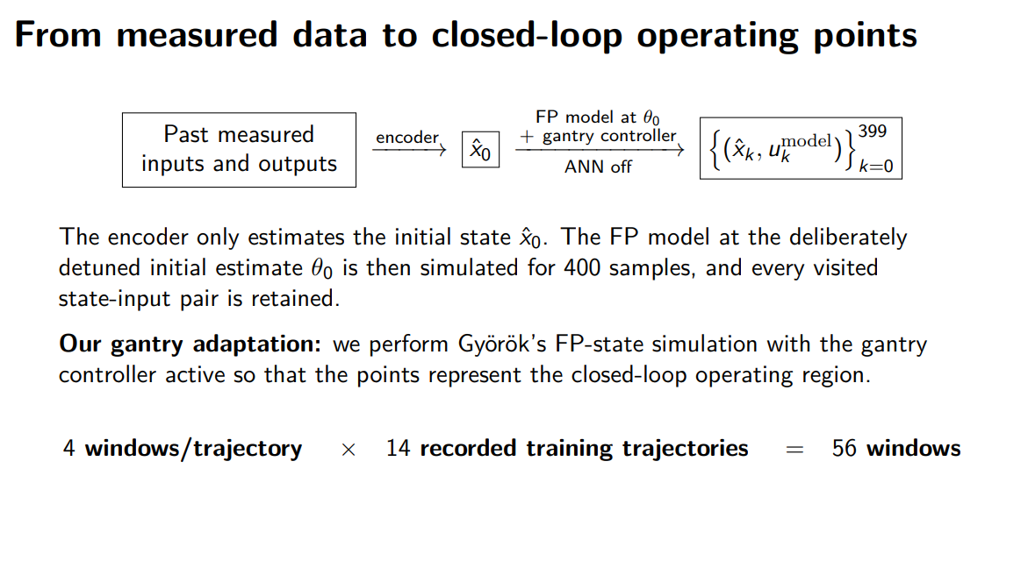
Notes:
SAY — HOW THE POINT SET IS BUILT
• Read the chain from left to right:
Past measured inputs and outputs
Encoder
Initial state estimate x̂₀
400-step rollout of the first-principles model
Gantry controller remains closed around the model
ANN is OFF
Every visited (state, input) pair is stored as one operating point
ROLE OF THE ENCODER
• The encoder is used for ONE thing only:
Estimating the initial state x̂₀ of each window.
• Gyorok does not need an encoder because the state is measured directly.
• We do not measure the full state.
• Therefore our SUBNET encoder enters here:
To initialise each rollout.
Nowhere else in the point-set construction.
THE ADAPTATION ON THIS SLIDE
• Gyorok:
Simulates the first-principles model OPEN LOOP.
Uses the recorded input.
• We:
Simulate the first-principles model CLOSED LOOP.
Recompute the controller action during the rollout.
WHY CLOSED LOOP?
• Our data only exist in closed loop.
• An open-loop first-principles simulation drifts away from the data.
• This is especially problematic because:
The X and Y axes are marginally stable.
• If we used that drifting rollout:
The point set would describe operating conditions the model never actually sees.
• With the controller closed:
The simulated rollout stays close to the recorded trajectory.
• Measured tracking error:
Approximately 1.4 × 10⁻⁴ in normalised output units.
THE COUNTS — WHERE 134,400 COMES FROM
• 4 windows per trajectory
• 14 training trajectories
• Therefore:
4 × 14 = 56 windows
• Each window contains:
400 samples
• Therefore:
56 × 400 = 22,400 operating points
• Each operating point contributes:
6 state rows
• Therefore:
22,400 × 6 = 134,400 rows
• Final regressor size:
134,400 rows
15 columns
IF ASKED — WHY IS THE ANN OFF?
• The point set should describe what the BASELINE model can do.
• It should not depend on the augmented model.
• Therefore the ANN is disabled during construction.
• Additional benefit with latent augmentation states:
They remain exactly zero.
IF ASKED — WHY 400 STEPS?
• 400 steps is the training horizon.
• So the operating points are collected over the same horizon used by the training objective.
IF ASKED — WHY ONLY 4 WINDOWS PER TRAJECTORY?
• It is a coverage-versus-computational-cost choice.
• Even with only 4 windows:
We obtain 22,400 operating points.
The regressor has only 15 columns.
• Therefore the stacked matrix is already extremely tall relative to its width.
• This comfortably satisfies the paper’s requirement that the stack be much taller than it is wide.
IF ASKED — WHICH WINDOWS ARE USED?
• Windows come only from the training trajectories.
• They are selected using a fixed random seed.
• Therefore the point set is reproducible.
IF ASKED — IS THE CONTROLLER REPLAYED OR RECOMPUTED?
• Recomputed.
• The controller is evaluated during the simulated rollout.
• The next slide explains this in detail.
WORDING — “NOMINAL FP MODEL”
• On the slide, “nominal FP model” means:
The first-principles model evaluated at θ₀.
• θ₀ is the run’s STARTING parameter vector.
• In these experiments:
θ₀ is deliberately detuned by 10%.
It is not the true parameter vector.
• If there is any confusion, say:
“First-principles model at θ₀.”

Slide 83
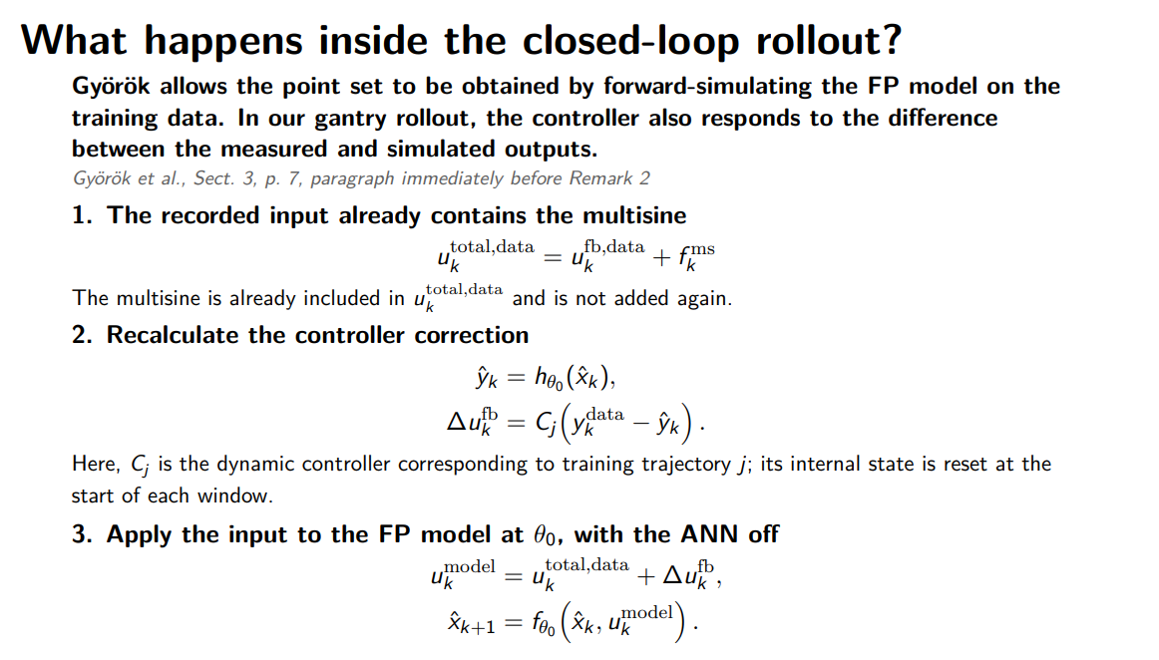
Notes:
SAY — THE ONE IDEA
• This is a RESIDUAL feedback loop.
• The model is driven by:
The recorded plant input
Plus a correction from the controller
• That correction is based on the mismatch between:
Measured output y_data
Simulated output ŷ
• If the model were perfect:
ŷ = y_data
The error is zero
The controller correction is zero
The model sees exactly the recorded input
• So the correction acts ONLY when the simulation begins to deviate.
• This is what keeps the simulated point set close to the measured data.
STEP 1 — REPLAY THE RECORDED INPUT
• The recorded input already contains the multisine.
• That is how the original data were generated.
• Therefore we replay:
u_total
• We do NOT add the multisine again.
• Otherwise we would inject it twice.
• Verified from the stored data:
u_total − (u_fb + f_ms) ≈ 1.5 × 10⁻⁵ N
• So u_total already contains both:
Feedback-controller input
Multisine excitation
STEP 2 — COMPUTE THE RESIDUAL CORRECTION
• Compute the simulated output ŷ from the current model state.
• Form the error against the MEASURED output:
y_data − ŷ
• Pass this error through controller C_j.
• C_j is trajectory-specific.
• Reason:
The controller was designed for the Y position of that trajectory.
• Across the 22 records:
There are 9 distinct controllers.
• Each C_j is dynamic:
9 controller states.
• At the start of every window:
Controller state x_c = 0.
STEP 3 — PROPAGATE THE FP MODEL
• Add the controller correction to the replayed input.
• Use that resulting input to step the first-principles model.
• Model parameters:
θ = θ₀
• ANN:
OFF
• Repeat this for all 400 steps of the window.
THE ADAPTATION RELATIVE TO GYOROK
• Gyorok propagates the first-principles model using only the recorded input.
• We add one adaptation:
Close the controller around the simulated model using the measured-output mismatch.
• Everything else follows the same point-set idea.
IF ASKED — WHY NOT USE PURE OPEN LOOP?
• The X and Y axes have no restoring stiffness.
• Therefore small model errors can integrate over time.
• In pure open-loop simulation:
The model gradually leaves the measured trajectory.
The resulting point set no longer represents the operating conditions actually seen in the data.
• With the residual controller closed:
The rollout tracks the measured outputs to approximately 1.4 × 10⁻⁴ in normalised units.
IF ASKED — WHY THIS RESIDUAL FORM INSTEAD OF DRIVING THE REFERENCE?
• This is the same form used in our training rollout.
• Therefore the point set reflects the operating conditions the model actually experiences during training.
• We are not trying to reproduce the original reference-tracking experiment.
• We are trying to keep the simulated model close to the recorded trajectory while replaying the measured plant input.
IF ASKED — WHY DOES x_c START AT ZERO?
• x_c = 0 is the controller initialisation for which the residual correction vanishes when the model is exact.
• If:
ŷ = y_data
• Then:
Error = 0
Controller correction = 0
• So the model receives exactly the replayed recorded input.
IF ASKED — HOW LARGE IS THE CORRECTION?
• Over the full point set:
On the two X channels:
correction RMS ≈ 12% of replayed-input RMS
On the Y channel:
correction RMS is comparable to the replayed input itself
• So the residual correction is NOT always a small perturbation.
• This also explains why pure open-loop propagation would not be adequate.
CITATION / SLIDE NOTE
• The current header cites Equation (4b).
• That equation describes the paper’s training rollout and includes the ANN contribution.
• The construction we are actually comparing against is different:
The first-principles simulation described in Section 3, page 7.
• Slide 3 already cites that location correctly.
• Ideally, this slide should use the same Section 3 citation rather than Equation (4b).
• Otherwise the two slides appear to cite different paper formulations for the same point-set construction.

Slide 84
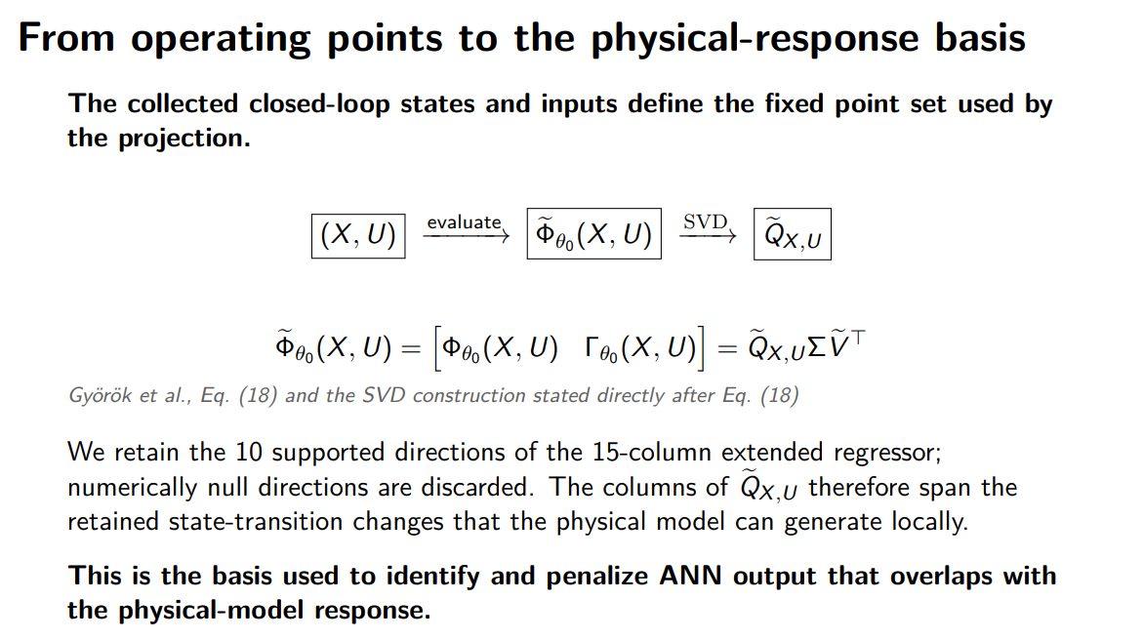
Notes:
we take the singular values and remove the ones that are numerically small, i think less then 10^-6
$$\frac{σ_{i}}{σ_{1}}>{10}^{−6},$$
or equivalently,
$$σ_{i}>{10}^{−6}σ_{1.}$$
So this is a relative threshold, not
$$σ_{i}>{10}^{−6}$$
SAY — THIS IS SLIDE 1 MADE CONCRETE
• This is the same equation as on slide 1.
• The difference is that (X,U) is now concrete.
• Here, (X,U) is:
The 22,400 operating points constructed on the previous slide.
• So:
Slide 1 = the general method.
This slide = the method applied to our point set.
FROM Φ̃ TO Q̃
• Evaluate Φ̃ at all 22,400 operating points.
• This gives a matrix with:
134,400 rows
15 columns
• The 15 columns are:
14 physical parameter-sensitivity columns
1 Γ column
• Then take the SVD.
• Q̃ is the orthonormal basis of the directions that the physical model can produce locally at these operating points.
THIS IS WHERE TRUNCATION ENTERS
• The 15 singular values, relative to the largest, are:
1
2.2 × 10⁻¹
3.7 × 10⁻²
2.8 × 10⁻³
1.1 × 10⁻³
2.8 × 10⁻⁴
4.0 × 10⁻⁵
3.3 × 10⁻⁵
3.0 × 10⁻⁵
1.7 × 10⁻⁶
4.9 × 10⁻⁷
4.2 × 10⁻¹⁸
2.6 × 10⁻¹⁸
1.1 × 10⁻¹⁸
1.7 × 10⁻²¹
• Interpretation:
11 physically real directions
Then an approximately 11-decade gap
Then 4 directions at numerical round-off
WHY FOUR DIRECTIONS ARE EXACTLY NULL
• These four directions correspond to:
kb₁ − kb₂
cb₁ − cb₂
Jb − Jh
One mass-splitting direction
• These are null by STRUCTURE.
• This is not caused by insufficient excitation or poor data.
• The governing equations only contain the corresponding parameter sums.
• Therefore no experiment can separate those individual parameters.
• They are structurally unidentifiable.
THE BASIS WE ACTUALLY KEEP
• Q̃ does NOT keep all 15 columns.
• We use a singular-value tolerance of:
10⁻⁶ relative to the largest singular value.
• Therefore:
The four round-off directions are removed.
The 11th direction at 4.9 × 10⁻⁷ is also removed.
• Final basis:
10 columns
IMPORTANT DETAIL — 11 REAL DIRECTIONS, BUT ONLY 10 KEPT
• The 11th direction is not structurally zero.
• Its singular value is:
4.9 × 10⁻⁷
• So it is weak, but real.
• Because our cutoff is 10⁻⁶:
It falls below the threshold.
We deliberately drop it.
• Therefore:
11 physically nonzero directions
10 directions retained in Q̃
IF ASKED — WHY TRUNCATE AT ALL?
• Singular values around 10⁻¹⁸ are numerical round-off.
• Keeping those directions would make the penalty charge the ANN for overlapping with numerical noise.
• Truncation therefore removes directions that do not represent meaningful physical sensitivity.
IF ASKED — WHY DOES THE PAPER KEEP ALL COLUMNS?
• The paper’s car regressor does not have this structural degeneracy.
• In our system:
Several parameter combinations are structurally indistinguishable.
• Therefore truncation is necessary here.
IF ASKED — DOES TRUNCATION CHANGE THE METHOD?
• No.
• The penalty is exactly the same.
• We simply use a smaller basis containing only numerically meaningful directions.
IF ASKED — IS THE JACOBIAN CORRECT?
• Yes.
• We checked the analytical Jacobian against central finite differences.
• Worst relative column error:
1.5 × 10⁻⁶
IF ASKED — WHAT DOES “LOCALLY” MEAN?
• “Locally” means:
First-order sensitivity with respect to θ
Around θ₀
Evaluated at the selected operating points
• So Q̃ describes the physical response space defined by the local Taylor expansion around θ₀.
PRESENTING HAZARD — SAME EQUATION AS SLIDE 1
• Slide 1 and this slide intentionally contain the same equation.
• The distinction is:
Slide 1 introduces the generalised method.
This slide instantiates it using our actual operating points and shows the resulting spectrum.
• The new information on this slide is therefore:
The concrete matrix dimensions
The SVD spectrum
The structural null directions
The truncation to 10 basis vectors
OPTIONAL DECK CHANGE
• If you want to avoid repeating the equation:
Remove it from this slide.
Keep the arrow diagram from Φ̃ to SVD to Q̃.
Keep the singular-value spectrum.
• The spectrum and truncation are the parts that are genuinely new here.

Slide 85
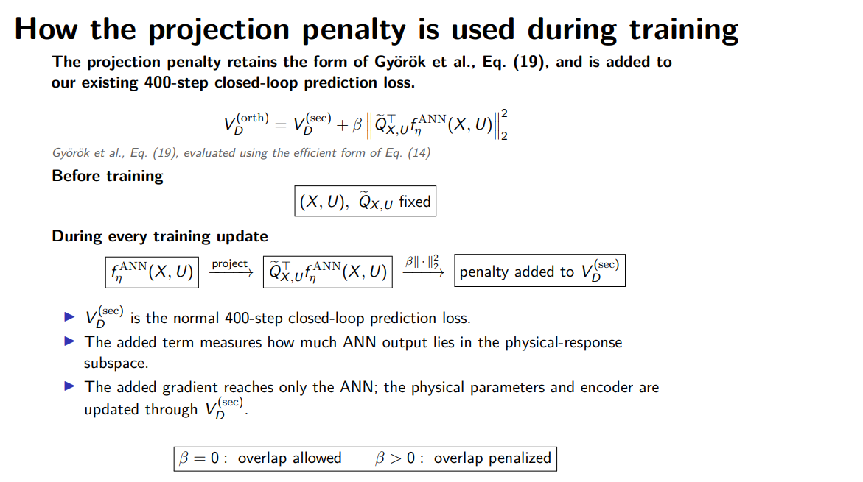
Notes:
You are not constructing $Q$from every minibatch.
Before training:
$$X, U, Q \text{are frozen}.$$
At every optimizer update you evaluate
$$f_{η}^{ANN}\left(X , U\right)$$
on this fixed reference point set.
Then:
$$c=Q^{⊤}f_{η}^{ANN}\left(X , U\right).$$
If
$$c_{i}≠0,$$
the ANN contains some amount of physical-response direction $q_{i}$.
SAY — WHAT THIS SLIDE ADDS
• The earlier penalty slide gave:
The formula.
The fixed-basis choice.
• This slide explains the MECHANICS:
What is computed once.
What happens at every training update.
ONCE — BEFORE TRAINING
• Construct the 22,400 operating points.
• Build the basis Q̃ from those points.
• Both are fixed for the entire training run.
• Neither depends on the ANN.
EVERY TRAINING UPDATE
• Evaluate the ANN on those same 22,400 fixed inputs.
• Project the ANN output with Q̃ᵀ.
• Square the projected component.
• Multiply by β.
• Add it to the prediction loss.
• That is it.
• There is:
No additional rollout.
No Jacobian.
No SVD.
COMPUTATIONAL COST
• Measured across both β sweeps:
Arms with the penalty ran only 1–3% slower than β = 0.
50 epochs took about 3 hours either way.
• So the orthogonality penalty is not the computational bottleneck.
GRADIENT OWNERSHIP
• The added term is a function of the ANN weights only.
• Therefore the penalty directly affects only the ANN.
• The physical parameters and encoder move through V(sec) alone.
• We verified this:
Their gradients are bit-identical with β on and off.
IF ASKED — WHY USE THE FIXED POINT SET INSTEAD OF THE CURRENT TRAINING BATCH?
• The basis Q̃ was built from those specific operating points.
• Therefore the ANN must be evaluated at those same points when applying the penalty.
• Otherwise:
We would evaluate the ANN at one set of operating conditions.
But project it onto a physical subspace constructed somewhere else.
• Using the fixed set also makes the penalty deterministic in the ANN weights.
• It does not become stochastic from batch to batch.
IF ASKED — IS β = 0 A TRUE BASELINE?
• Yes.
• β = 0 is a true no-op.
• The penalty term is not added at all.
• It is not computed and then multiplied by zero.
IF ASKED — WHY DOES β NOT TRANSFER FROM THE PAPER?
• Our penalty is an UNNORMALISED sum over:
134,400 rows.
• V(sec) is a MEAN prediction loss.
• So the two terms have different numerical scales.
• β therefore carries both:
The desired strength of the orthogonality penalty.
The scale difference between the two loss terms.
• Therefore the β value from the paper cannot be transferred directly.
PHRASING WARNING — “NO GANTRY-SPECIFIC ADAPTATION”
• Be precise here.
• The PENALTY itself needs no gantry-specific adaptation.
• The complete training objective does.
• Our V(sec) is:
A 400-step closed-loop prediction loss.
Initialised using the encoder.
• The paper uses:
A 15-step cost.
Measured initial states.
• So say:
“The penalty needs no gantry-specific adaptation.”
• Avoid:
“This stage needs no adaptation.”

Slide 86
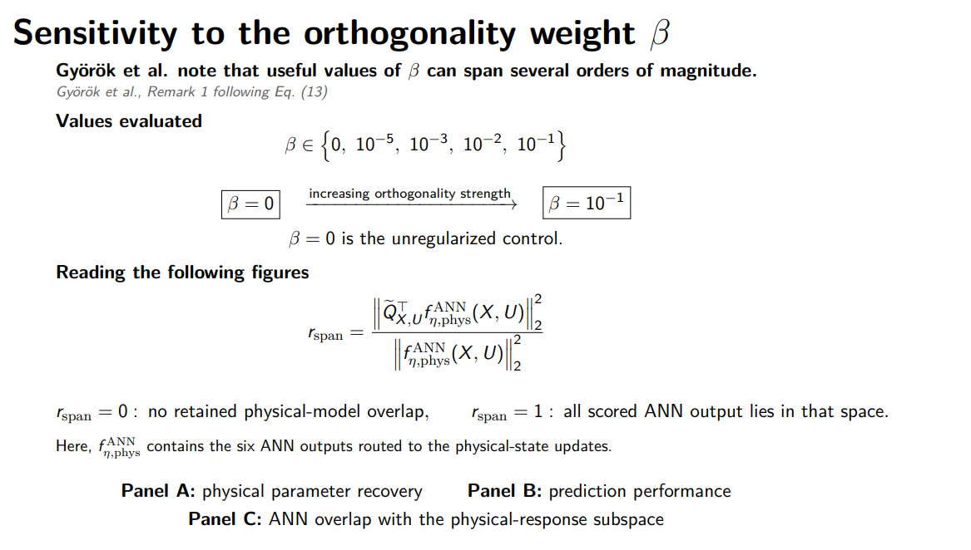
Notes:
fraction of ANN correction energy that looks physically reproducible​
If
$$r_{span}=0,$$
the scored ANN correction is entirely orthogonal to the retained physical-response space.
If
rspan​=1,
Your beta range is four decades above the paper's and the slide does not say so. Gyorok uses 1e-7 noiseless and calls 1e-7 to 1e-5 the useful range; our flat region is 1e-5 to 1e-1. A supervisor who knows the paper will ask. The answer is in your favour: the penalty is a sum over 134400 regressor rows with no averaging, so beta absorbs the sample count and is not transferable. One line, and it demonstrates you understand the convention rather than copied a number.
The numerical scale of \(\beta\) depends on the point set, normalization, and penalty aggregation. Therefore, the value selected in Györök’s example is not directly transferable to our gantry.
SAY — WHAT r_span MEANS
• r_span measures the share of the ANN output that lies inside the physical response space.
• Because Q̃ has orthonormal columns:
r_span is bounded between 0 and 1.
• Interpretation:
r_span = 0
The ANN is producing behaviour that the physical parameters could not reproduce.
r_span = 1
Everything the ANN produces could also have been produced by changing the physical parameters.
• Important:
This ratio is OUR diagnostic.
• The paper penalises only the numerator.
• We divide by the total ANN output energy so that the quantity is easier to compare across arms with different ANN-output magnitudes.
HOW TO READ THE NEXT TWO FIGURES
• β = 0 appears to the LEFT of the dashed break.
• It is the control condition.
• It is NOT a point on the logarithmic β-axis.
• The small n below each tick gives:
The number of seeds behind that point.
• Panels:
Panel A = parameter recovery
Compared against the deliberately detuned starting parameters.
Panel B = prediction performance
Closed-loop free-run RMS on the validation data.
Panel C = r_span
WHAT TO POINT AT
• Start with Panel C — this shows the MECHANISM.
At β = 0:
r_span ≈ 0.89
For every nonzero β:
r_span < 10⁻⁶
• So the penalty almost completely removes ANN behaviour that overlaps with the physical response space.
• Then Panel A — this is the INTERPRETABILITY PAYOFF.
Parameter error decreases monotonically as β increases.
• In other words:
Forcing the ANN out of the physical subspace improves physical-parameter recovery.
• Finally Panel B — this is the PRICE.
Prediction performance degrades slightly.
The degradation is also monotonic with β.
• So there is a trade-off:
Better parameter recovery.
Slightly worse prediction.
DIFFERENCE BETWEEN THE TWO FIGURES
• First figure:
No latent augmentation states.
• Second figure:
Two latent states.
• The same overall trade-off is therefore evaluated with and without latent augmentation dynamics.
IF ASKED — WHY IS YOUR β SO DIFFERENT FROM THE PAPER?
• Our selected value is:
β = 10⁻²
• The paper selects approximately:
β = 10⁻⁷
• But the RANGE explored is actually comparable.
• The paper’s Figure 3 sweeps roughly:
10⁻⁹ to 10⁻¹
• So the important difference is the selected value, not the order of magnitude covered by the sweep.
WHY THE SELECTED β DOES NOT TRANSFER
• Our orthogonality penalty is an UNNORMALISED sum over:
134,400 rows.
• Our prediction loss is approximately:
10⁻⁸
• Therefore the numerical scales of the two loss terms are very different.
• β absorbs both:
The desired strength of the orthogonality constraint.
The relative scaling between the penalty and prediction loss.
• Therefore the paper’s numerical β cannot simply be adopted in our implementation.
SLIDE FIX 1 — REMARK NUMBER
• Remark 1 follows:
Equation 13
• Not:
Equation 14
SLIDE FIX 2 — PANEL DESCRIPTION
• The current panel list does not match the figures.
• Correct description:
A = parameter recovery
B = prediction
C = r_span
• Standalone first-principles performance is NOT plotted.
IF ASKED — WHAT HAPPENS TO THE STANDALONE FP MODEL?
• Its validation error changes only slightly across the sweep:
Approximately 15.3 µm
To approximately 14.2 µm
• Because that variation is small, it is better reported in a table rather than as another panel.
ONE-SENTENCE TAKEAWAY
• The orthogonality penalty does exactly what it is supposed to do: it drives the ANN out of the physical parameter space, improves parameter recovery, and pays for that with a small loss in prediction accuracy.

Slide 87
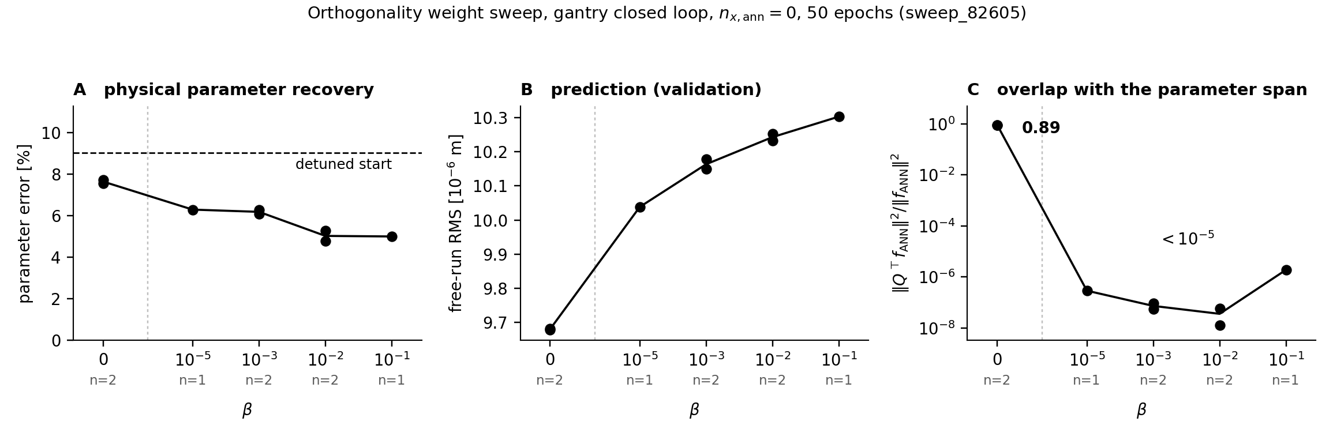
Notes:
N = number of seeds

Slide 88
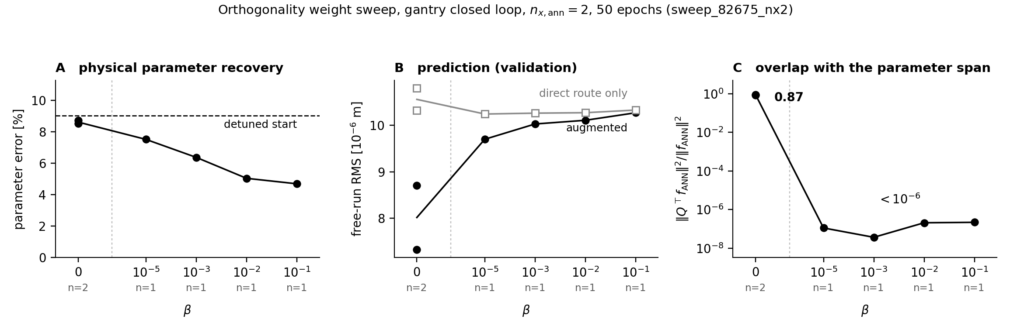
Notes:
what is in the nx=2 figure direct route only and augmented in panel B?Both are the same trained model, scored two different ways by gating the ANN's output columns.augmented is the model as trained: the ANN writes the six physical rows and the two latent rows, and the encoder supplies both the physical and the latent initial state. This is the model you would ship.direct route only is the same weights with the latent path switched off in two places at once. The ANN's two latent-writing output columns are zeroed, and the encoder's latent initial state is zeroed. With both off, the latent states are identically zero for the whole 400-step rollout, so the ANN acts as a pure static correction evaluated at x_aug = 0. That is exactly the slice the penalty is evaluated on, which is why it is the right comparison: it is the part of the model the penalty actually controls.
❯ so is there now a clear way to show that the additional states dont affect anything, because if i look at C overlap. there is barely no overlap. so it might not be worth looking into
Panel C is the wrong number to judge that on. It plots the overlap on the penalty's own point set, where the latent states are held at zero. By construction it says nothing about them.

Slide 89
Next slides
Suggestion extending for additional states
Current implementation: only ANN corrections in the physical-state coordinates are penalized; the additional learned-state dynamics are unconstrained.
Notes:
If orthogonality is defined in the one-step extended-state update, the extra-state coordinates are automatically orthogonal because the baseline block there is zero.
keep the baseline parameters interpretable by preventing the learned model from taking over baseline-representable dynamics

Slide 90
Next slides
Suggestion extending for additional states
Current implementation: only ANN corrections in the physical-state coordinates are penalized; the additional learned-state dynamics are unconstrained.
Györök-style orthogonality: orthogonality is defined only with respect to the baseline-representable subspace. Since the baseline has no dynamics in the additional-state coordinates, those coordinates are orthogonal to the baseline by construction.
  Baseline is zero in those coordinates so automatically orthogonal
Notes:
If orthogonality is defined in the one-step extended-state update, the extra-state coordinates are automatically orthogonal because the baseline block there is zero.
keep the baseline parameters interpretable by preventing the learned model from taking over baseline-representable dynamics

Slide 91
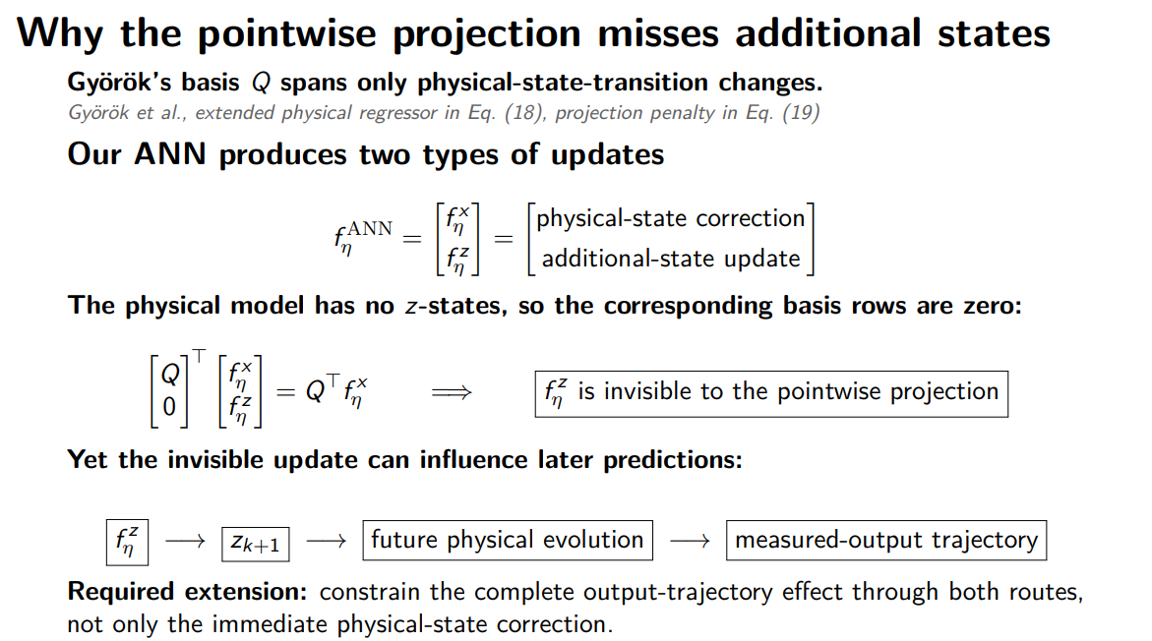
Notes:
We regularize at the trajectory level because one-step orthogonality is not preserved by nonlinear recurrent and closed-loop propagation, so locally orthogonal ANN corrections may still reproduce the output effect of changing physical parameters.
Additional-state corrections are invisible to the one-step physical subspace but can later re-enter the measured dynamics, allowing them to reproduce physical behavior over a trajectory.
For example,
$$z_{k+1}=az_{k}+b\left(x_{k},u_{k}\right), x_{k+1}=f_{θ}\left(x_{k},u_{k}\right)+cz_{k}.$$
The injection into \(z_{k+1}\) has no immediate physical-output effect, so the one-step penalty may not detect it. After one or more steps, however, \(cz_k\) changes the physical state. This indirect, delayed path is captured only by trajectory-level sensitivities.
The issue is that one-step orthogonality does not guarantee trajectory orthogonality.
Therefore:
\[ \boxed{\text{one-step correction}=\text{instantaneous ANN injection into }x_{k+1}} \]
and the limitation is:
\[ \boxed{\text{instantaneous separation can disappear after recurrent propagation}} \]
at the sampled points, that correction propagates through the dynamics, additional states, encoder, and controller. Over multiple steps, it can still produce an output trajectory similar to one obtained by changing the physical parameters.
So the ANN may still “steal” physical behavior at the trajectory level—the level at which your model is trained and evaluated.
The zero block is our embedding of Györök's physical basis, not something appearing explicitly in their paper. That distinction is worth saying aloud.
Main point projection doesn’t take into account the additional states
Hence the $z$-update has entered the physical trajectory through the dependence of the later $x$-update on $z_{k+1}$.
Györök asks whether the ANN's immediate state-transition correction looks like something the physical model can generate. Our problem is harder: an ANN update can be orthogonal or even completely invisible at the instant it is produced, yet after propagation through a learned internal state it can generate the same measured-output trajectory change as a physical-parameter variation.
SAY
• The ANN writes two kinds of rows:
Corrections to the physical states.
Updates to the additional states z.
• The physical model has no z states.
• Therefore the physical-response basis has zero rows in those directions.
• Q̃ᵀ f_ANN only acts on the physical-state rows.
• fᶻ never enters the penalty.
• That is exact, not an approximation.
PRECISE MECHANISM IN OUR MODEL
• fᶻ is still not harmless.
• It sets z at the next step.
• z then feeds back into the ANN and can change the output later.
• Our output map reads ONLY the six physical states.
• Therefore z reaches the output through exactly one path:
z
→ ANN input
→ ANN writes physical rows
→ physical states
→ output
• There is no direct z-to-output term.
WHAT WE MEASURED
• The blind spot is real.
• Overlap on the trajectory actually visited by the trained model:
≈ 10⁻³
• Overlap seen by the penalty on its fixed point set:
≈ 10⁻⁷
• So the realised overlap is about four orders of magnitude larger.
• The pointwise penalty is therefore genuinely blind outside its fixed slice.
DO NOT OVERCLAIM
• The amount that escapes is still small.
• We did NOT observe the augmentation moving into the latent route to avoid the penalty.
• In fact:
At β = 0:
latent contribution ≈ 32%
At β = 10⁻²:
latent contribution < 2%
• Because z can only affect the output through the penalised physical rows, shrinking those rows also shrank the latent route.
HONEST CLAIM
• The pointwise penalty cannot see the latent route directly by construction.
• In our architecture, it happens to suppress that route indirectly anyway.
• With a direct z-to-output map, that would no longer be guaranteed.

Slide 92
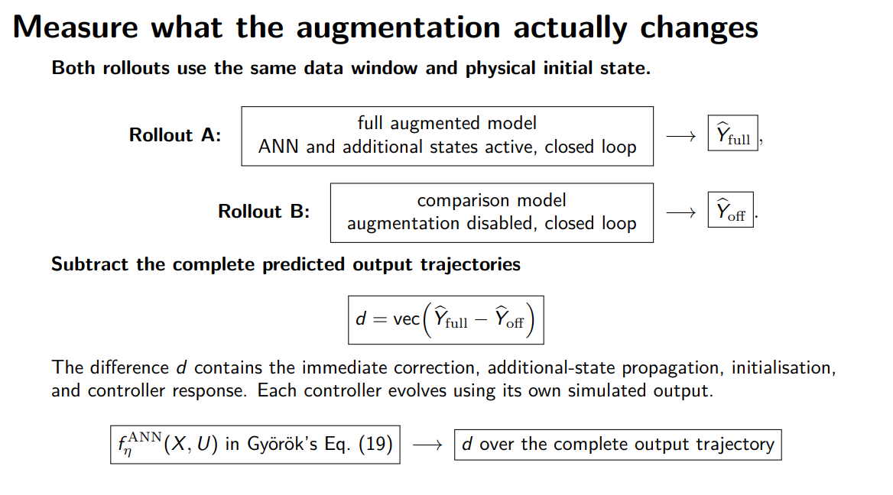
Notes:
The important conceptual move here is that $d$is not a residual against measured data. It is a counterfactual difference between two predictions made with the same physical model.
while the comparison rollout uses the same physical parameters, physical initial state, horizon and input sequence, but removes the learned augmentation
This makes $d$answer a very concrete question:
“At the present trained parameter values, how much does having the augmentation active change the predicted output trajectory?”
SAY
• Take two rollouts on the same window.
• Both use the same physical initial state.
• Rollout 1:
Full augmentation active.
• Rollout 2:
Augmentation disabled.
• Subtract the complete predicted output trajectories.
• Call that difference:
d
• d is what the augmentation actually changes over the rollout.
WHY d AND NOT f_ANN?
• f_ANN is the instantaneous correction at one point.
• d is the realised effect after 400 steps.
• It contains:
Immediate corrections.
Latent propagation.
Latent initialisation.
The controller’s reaction to both.
• Gyorok’s Eq. 19 penalises the first.
• We replace it with d.
THE CONTROLLER SUBTLETY
• The two rollouts produce different outputs.
• Therefore their controllers also compute different corrections.
• That difference is included in d.
• This is intentional.
• The controller response is part of what the augmentation changes about the closed-loop system.
IF ASKED — WHAT HAPPENS TO ẑ₀?
• In the full rollout:
ẑ₀ is active.
• In the comparison rollout:
It is disabled with the augmentation.
• Therefore latent initialisation effects remain inside d.
• This is made explicit on the final extension slide.
IF ASKED — COST
• The pointwise method requires only one ANN forward evaluation.
• Computing d requires two complete rollouts per penalty evaluation.
• That is why the pointwise method is cheap and this trajectory method is not.

Slide 93
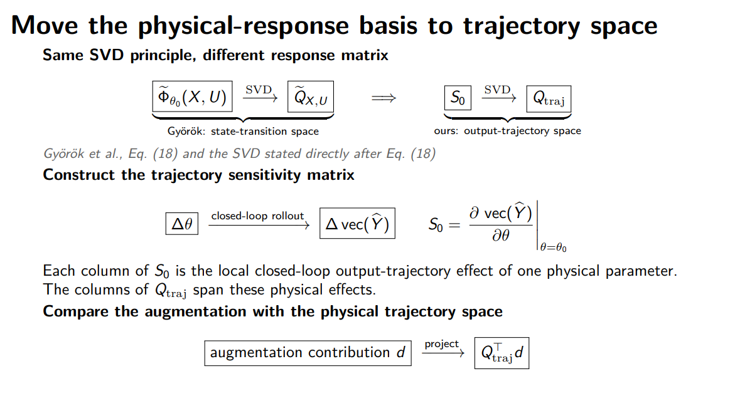
Notes:
S0​ is best understood as the Jacobian that tells you how the entire predicted output trajectory changes when you infinitesimally change the physical parameters.
That is all it is. The important part is that its “output” is not one state update; its output is the whole stacked prediction trajectory.
range(S0​)​
is the set of all output-trajectory changes that can be produced, to first order, by changing the physical parameters.
SAY
• Same principle as Gyorok, but applied to a different object.
• Gyorok takes the SVD of the state-transition sensitivity.
• We take the SVD of the trajectory sensitivity.
WHAT S₀ MEANS
• Column i of S₀ is constructed by:
Perturbing physical parameter i.
Rolling the closed-loop model for 400 steps.
Measuring how the complete predicted output trajectory changes.
• Each column therefore represents the realised closed-loop effect of one physical parameter over the full horizon.
• It is not a one-step sensitivity.
FROM S₀ TO Q_traj
• Take the SVD of S₀.
• Q_traj spans the trajectory changes that physical parameter variations can produce.
• Then project d onto Q_traj.
• So the principle is exactly the same as before.
• The difference is that everything now lives in trajectory space.
WHY THIS IS THE RIGHT COMPARISON
• d is a predicted output trajectory.
• The columns of S₀ are predicted output trajectories.
• So they live in the same space.
• The question becomes:
“Could a parameter change reproduce what the augmentation did?”
• That is the question the original method was always trying to ask.
IF ASKED — COST
• S₀ requires one rollout sensitivity per physical parameter.
• We have 14 physical parameters.
• Then we take an SVD.
• The basis is built once at a frozen reference.
• It is NOT recomputed every training update.
IF ASKED — WEIGHTING
• The implementation also includes a weighting.
• This puts the trajectory penalty in the same metric as the prediction loss.
• It is omitted from the slide for space.
STATUS
• Implemented.
• Structurally verified.
• β has NOT yet been selected using an L-curve.
• Therefore:
No efficacy claim yet.
Only a structural and implementation claim.

Slide 94
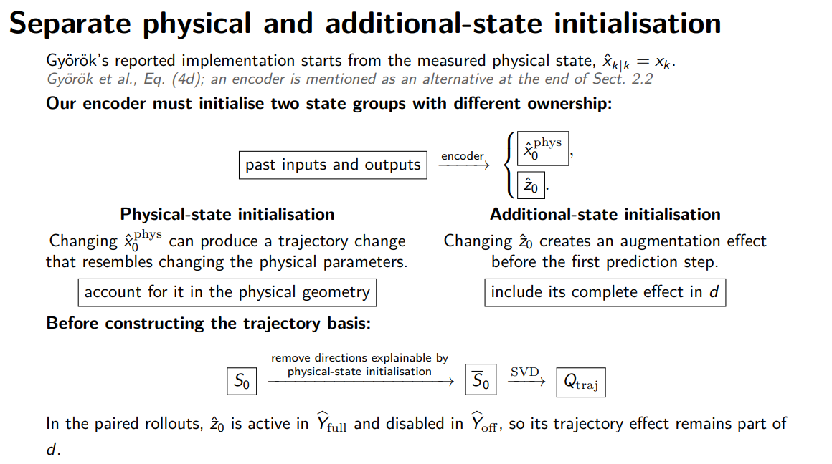
Notes:
remove the portion of the physical-parameter sensitivity that can already be explained by physical initial-state freedom.
Sˉ0​ is simply $S_{0}$after removing the part of each physical-parameter trajectory effect that could also be produced by changing the estimated physical initial state.
and each column of $S_{0}$says:
“If I slightly change one physical parameter, what trajectory change do I see?”
SAY
• Gyorok starts from the measured state.
• We do not measure the full state, so we estimate it.
• Our encoder produces two different quantities with different roles:
x̂₀,phys
ẑ₀
PHYSICAL INITIAL STATE — x̂₀,phys
• Moving x̂₀,phys can imitate the effect of changing a physical parameter.
• Therefore it is a nuisance direction.
• These directions must be removed from the physical-response basis before we project the augmentation onto it.
ADDITIONAL-STATE INITIALISATION — ẑ₀
• Moving ẑ₀ is itself an augmentation effect.
• Therefore it belongs inside d.
• It should NOT be profiled out.
THE WHOLE SLIDE IN ONE SENTENCE
• Physical-state initialisation gets profiled out.
• Additional-state initialisation gets counted in.
WHY IT MATTERS
• If we skip the profiling, the physical basis can contain directions that the encoder itself could have produced.
• We could then penalise the augmentation for behaviour that actually belongs to the encoder.
• Profiling removes that ownership ambiguity.
IF ASKED — DID THIS MATTER NUMERICALLY?
• Measured on the reference checkpoint:
Encoder nuisance basis rank = 12
Physical rank before profiling = 10
Physical rank after profiling = 10
• So profiling removed no physical directions at that checkpoint.
HONEST CLAIM
• The concern is real in principle.
• But it was not binding on the checkpoint we measured.
• So this should be described as:
A structural safeguard.
Not a demonstrated numerical correction in this experiment.

Slide 95
Orthogonal by construction
Penalty-based orthogonality introduces a trade-off between prediction accuracy and model complementarity
  The regularization weight Beta is difficult to select
  Beta affects the cost function
With orthogonal-by-construction we instead restrict the learned model itself
  → Training only has to minimize prediction fit, no trade off in choosing Beta

Slide 96
To do
Orthogonal by construction

Slide 97
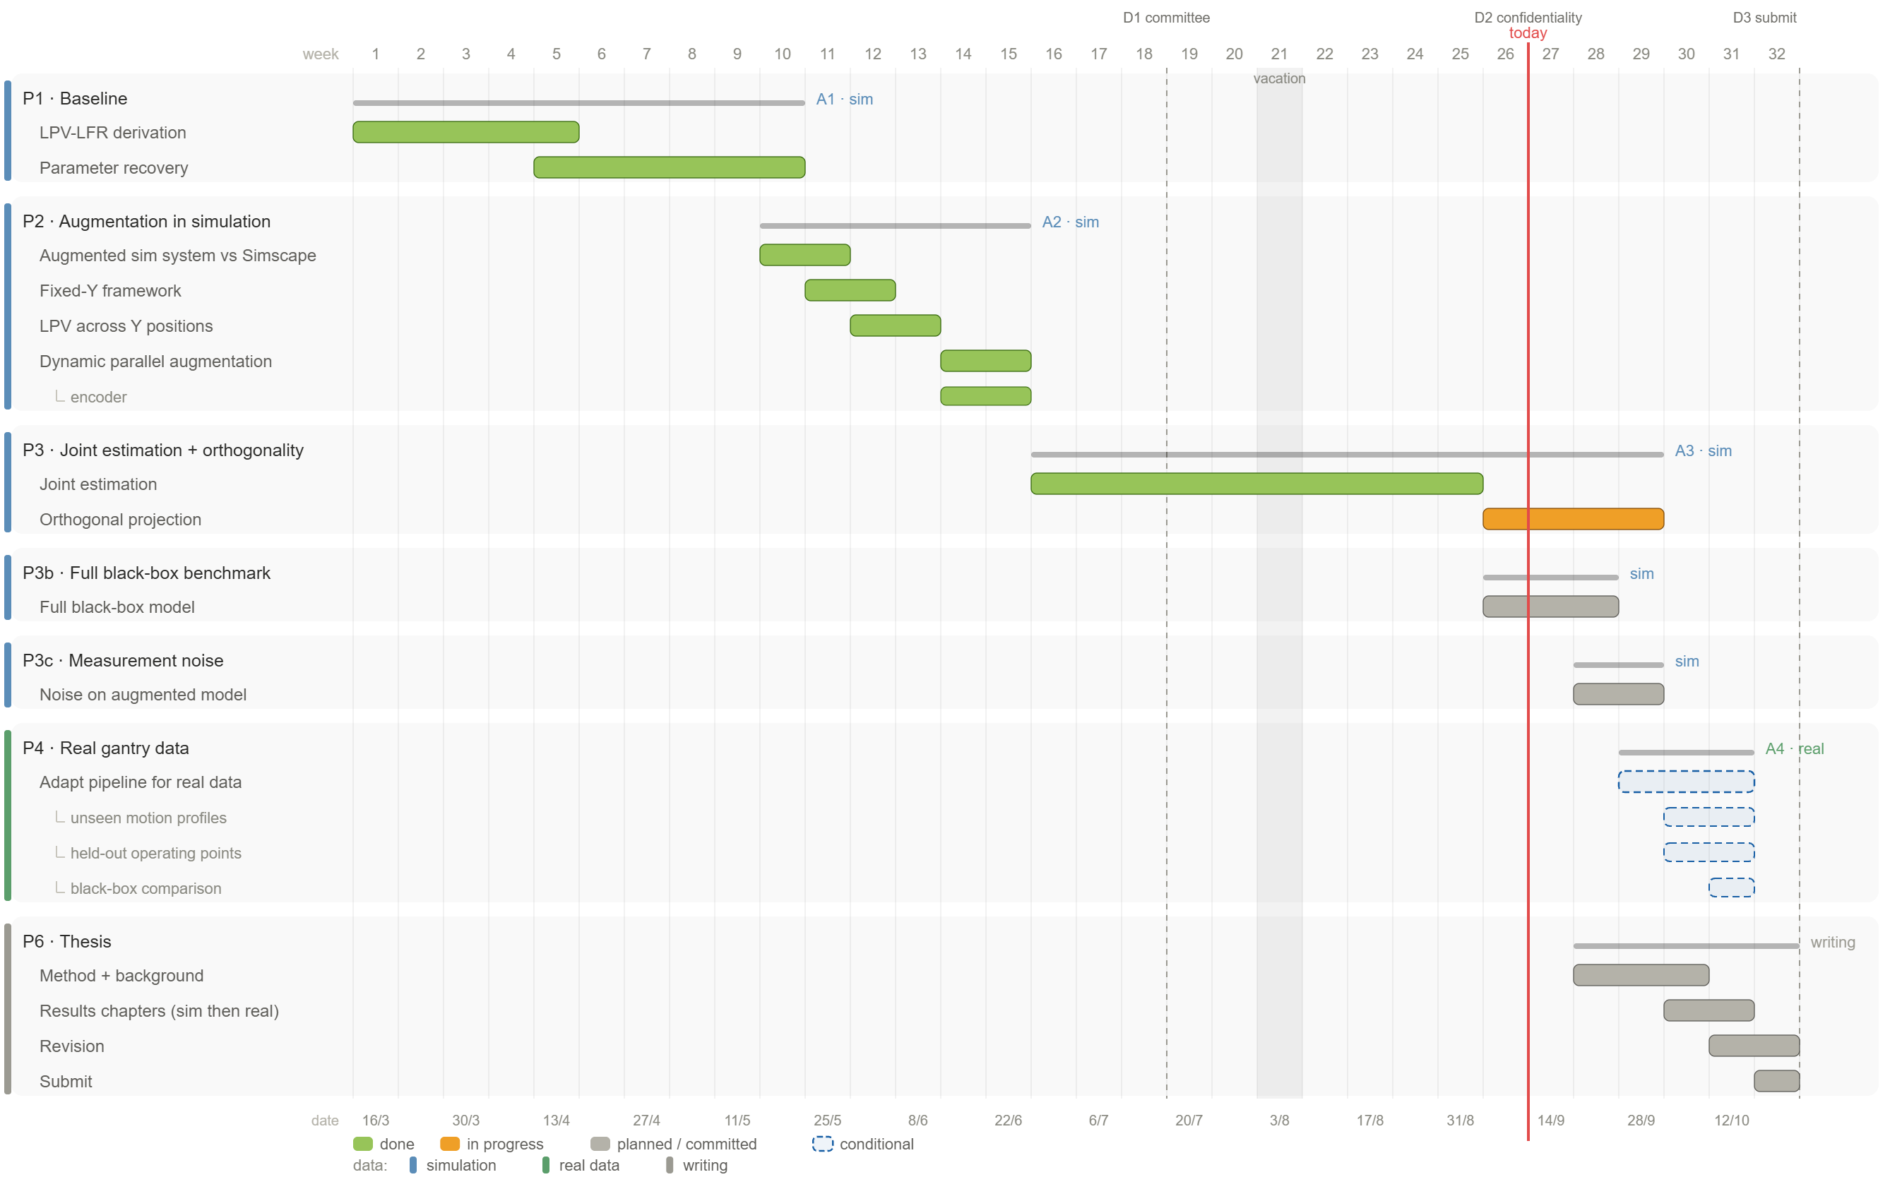
Planning

Slide 99
Notes:
Each simulation window we start with zero controller correction.
ŷ[k] = h(x[k]) <- model output at k, from the STATE only
e[k] = y[k] - ŷ[k]
u_fb[k]= Cc xc[k] + Dc e[k]
û[k] = u[k] + u_fb[k]x[k+1] = f(x[k], û[k]) <- û[k] produces ŷ[k+1], not ŷ[k]
xc[k+1]= Ac xc[k] + Bc e[k]
ŷ[k] is used to build û[k]; û[k] then moves the state forward and so determines ŷ[k+1]. It is not the same ŷ on both sides of the equal sign, it is k and k+1.
- Controller initial condition. xc = 0 at every window start.

Slide 100
Notes:
Each simulation window we start with zero controller correction.
ŷ[k] = h(x[k]) <- model output at k, from the STATE only
e[k] = y[k] - ŷ[k]
u_fb[k]= Cc xc[k] + Dc e[k]
û[k] = u[k] + u_fb[k]x[k+1] = f(x[k], û[k]) <- û[k] produces ŷ[k+1], not ŷ[k]
xc[k+1]= Ac xc[k] + Bc e[k]
ŷ[k] is used to build û[k]; û[k] then moves the state forward and so determines ŷ[k+1]. It is not the same ŷ on both sides of the equal sign, it is k and k+1.
- Controller initial condition. xc = 0 at every window start.

Slide 101
Baseline model

Slide 102
System for data generation

Slide 103
Augmentation
Overview
Notes:
Kijken gaug is dat augmented states?

Slide 104

Model = System

Slide 109
what are the main differences between us and gyorok in this implementation?
he uses real states right and no subnet to estimate, or am i wrong?
what else is important to mention? closed-loop is one part.

Slide 110
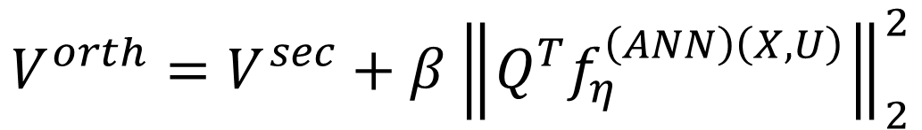
$$V^{orth}=V^{sec}+β{\left\|Q^{T}f_{η}^{\left(ANN\right)\left(X,U\right)}\right\|}_{2}^{2}$$

Slide 111
Nonlinear projection applied to gantry
$$Φ_(θ̄)(X,U)=(∂f_θ(X,U))/(∂θ)|_(θ=θ̄), Γ_(θ̄)=f_(θ̄)−Φ_(θ̄)θ̄$$
$$Φ₀(X,U)=D_θ f_θ(X,U), θ=θ₀$$

Slide 112
$$V^{orth}=V^{sec}+β{\left\|Q^{T}f_{η}^{\left(ANN\right)\left(X,U\right)}\right\|}_{2}^{2}$$

Slide 113
$$V^{orth}=V^{sec}+β{\left\|Q^{T}f_{η}^{\left(ANN\right)\left(X,U\right)}\right\|}_{2}^{2}$$

Slide 114
Adapt orthogonality regularization to our situation
1. Training cost. His is an open-loop 15-step-ahead cost from measured initial states, no encoder. Ours is the production 400-step closed-loop rollout with the controller in the loop and a trained encoder supplying x0. The penalty attaches to the ANN identically, but the fit objective around it is a different one.2. Point set. His primary setting uses measured states; we are his Remark 2 fallback, FP-simulated states, in closed loop. Measured to track the data to 1.4e-4 normalised, so the fallback is benign here.3. Basis truncation. He keeps all columns; we keep 10 of 15 because four directions are structurally null in our baseline. His car regressor has no such degeneracy.4. Rows augmented. He corrects only the velocity states; we route to all six physical rows. This matters more than it looks: our penalised networks put their surviving correction on the theta-position row, which his structure forbids.5. Nature of the model deficit. His missing physics is a static force map, which a static ANN can represent, hence his tenfold gain. Ours is a hidden absorber, dynamic, which a static correction cannot represent, hence our twofold gain.6. Selection on validation, not on test as in his Figure 3. And theta lives in log coordinates internally, with the regressor converted back to raw theta, which leaves the span unchanged.

Slide 115
Main issues about implementing orthogonality
No constraint for the additional states
No SUBNET / encoder init
No trajectory rollout only next step
  Our implementation is recurrent / has memory

Slide 116
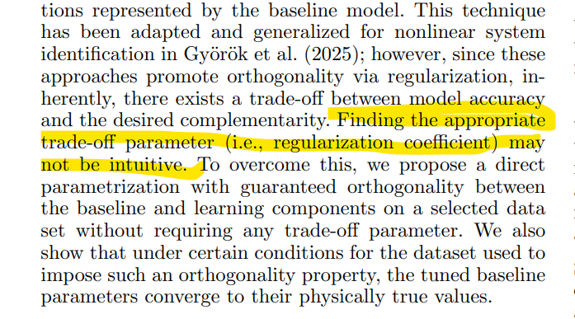
Kijken paper maarten en roland orthogonality regularization
Commentaar op kiezen beta, gyorok en maarten en roland
  Daarom weggestapt van regularizer
Bolderman 2024 (ISS PGNN feedforward, arXiv 2301.08568) / iets van een oplossing ipv hoe beta geestimate wordt.
Hier wordt bolderman ook al gereferenced, maar state dat niet intuiatief is voor regularization

Slide 117
Closed-loop
What changes about the method

Slide 118
Batch sized training
What changes about the orthogonality constraint

Slide 119
Update each epoch the baseline what the ANN needs to be orthogonal to?
Maybe not required / small benefit.

Slide 120
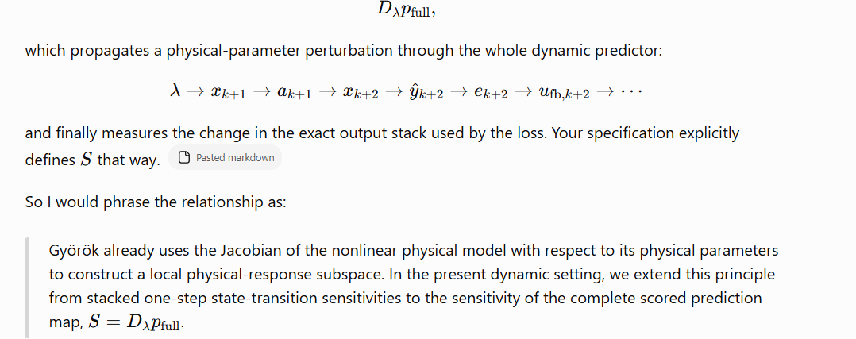
Trajectory method instead of pointwise
Gyorok does one step.
Adapt to trajectory similar as Kon

Slide 121
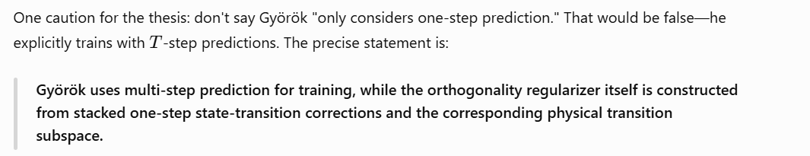


One step correction doesn’t apply
Main question to answer: Why does one step not work for us?:
  Additional / latent state keeps propagating?
  Rollout because.. Gyorok his ANN is memoryless, but his training rollout does have temporal propagation.
    Their learned terms enters additively → learned contribution is directly observable from the architecture
Due to laten states / additional states
One caution: Györök says “fixing the learning component to zero” when motivating estimation of the FP model under full-state measurement. That should not be interpreted as their regularizer performing an ANN-on/ANN-off trajectory subtraction. Their actual orthogonality term projects the directly evaluated ANN correction.

Slide 122

Due to running both outputs this includes:
NONlinear model, controler, scheduling AND output map

Slide 123


The important limitation
This construction does not establish that the latent-state encoder itself cannot mimic physics.
It establishes only that its contribution, together with the rest of the augmentation, is penalized when the resulting trajectory effect aligns with the profiled physical tangent.

Slide 124

Limitation not fully extending Gyorok his nonlinear capabilities
That is much narrower than:
  “the ANN can no longer mimic the physics.”

Slide 125

Encoder
Gyorok doesn’t use SUBNET, but does reference (Beintema et al., 2023)
Our encoder problem comes from the trajectory formulation, not from being in state space. We created it by moving the constraint onto a rollout, which we did because the pointwise form cannot see the latent path.

Slide 126
Why is this called “profiling out” the encoder?

Slide 127

Magnitude states

Slide 128
Instead of making the additional states themselves orthogonal
Propogate what they do the physical output trajectory
Do not make the additional states themselves orthogonal. Propagate what they do to the physical/output trajectory, and apply Györök's projection there.
“The new penalty detects a nonzero projection of a latent-mediated contribution onto the physical sensitivity space.”

Slide 129


Yes—that is the main reason.
The additional states $a_{k}$are internal coordinates of the neural model. They do not have a fixed physical meaning, and their numerical values can be changed by a coordinate transformation without changing the model's physical predictions.
For example, if
$$a_{k}^{′}=10a_{k},$$
and we compensate by changing the latent-to-physical mapping
$$K_{k}^{′}=\frac{1}{10}K_{k},$$
then
$$K_{k}^{′}a_{k}^{′}=K_{k}a_{k}.$$
So the physical behavior is identical, even though the additional-state values are ten times larger. Therefore a penalty directly on $a_{k}$, such as
$$∥a_{k}∥^{2},$$
would depend on an arbitrary neural-state scaling rather than on how much the augmentation interferes with the physics.
There is also a more basic issue with “orthogonality.” Györök's physical sensitivity directions live in physical-state/output space:
$$\frac{∂\hat{y}}{∂κ}.$$
But $a_{k}$lives in the learned latent-state space. Asking
$$a_{k}⊥\frac{∂\hat{y}}{∂κ}$$
does not even make sense directly: they are vectors in different spaces.
What matters for our objective is what the latent states cause in physical/output space:
$$a_{k}⟶K_{k}a_{k}⟶\text{future physical states}⟶{\hat{y}}_{k:T}.$$
Once propagated there, both quantities are comparable:
$$\underset{\text{physical prediction direction}}{\underbrace{\text{effect of changing }κ}} \text{vs.} \underset{\text{prediction contribution}}{\underset{⏟}{\text{effect caused by the augmentation states}}}.$$
Then orthogonality has the meaning we actually want:
$$\boxed{\text{the learned dynamics should not produce the same prediction changes as changing physical parameters.}}$$
One distinction: if by “output of the additional states” you mean the physical correction produced from them, such as
$$c\left(x , a , u\right)−c\left(x , 0 , u\right),$$
then yes, that can be regularized because it is already in physical-state coordinates. But regularizing only that latent route would leave the ANN's direct correction $c\left(x , 0 , u\right)$free to imitate the physical parameters. Hence for the main method we want the total augmentation effect, including both direct and latent routes.
So, in one sentence:
We do not orthogonalize the latent states because their coordinates are arbitrary; we orthogonalize what they ultimately do to the physical predictions, because that is where substitution for physical parameters actually occurs.

Slide 130
We constrain what the additional states do to predictions, not their values or magnitudes. This promotes orthogonality of the total contribution; it does not guarantee each path is separately orthogonal.
Györök penalizes the ANN’s one-step correction where it overlaps with stacked physical-parameter sensitivities.
Our proposed extension penalizes the ANN’s complete output-rollout contribution, using stacked rollout sensitivities instead.
The additional states evolve normally during the full rollout. Comparing that prediction with an ANN-off rollout captures their delayed effects through the physical dynamics. Thus, the penalty sees the latent feedback route that evaluation at \(x_{\rm aug}=0\) misses.
We constrain what the additional states do to predictions, not their values or magnitudes. This promotes orthogonality of the total contribution; it does not guarantee each path is separately orthogonal.

Slide 131


